Slide 1
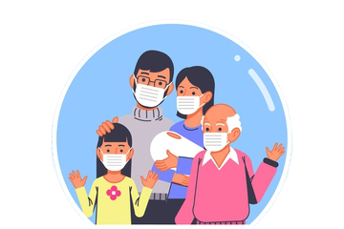
ProtectYOU
A Self-Isolation solution

Slide 2
Hello!
We’re team JavaBrew
Shika Shyam – 002194543
Alisha Mary Angalan – 002102014
Sai Raghavendra Viravalli - 001568587

Slide 3

PROBLEM
STATEMENT
ProtectYOU
We aim to build an application that makes self-quarantining easy for those patients affected with COVID who need to self-isolate but finds themselves without the means to do so.
The target audience for our application are:
Patients who do not have the facilities in their home to self-quarantine (does not have separate room with attached bathroom.
Patients who cannot afford expensive hotel accommodations to quarantine themselves.
Patients who simply want to isolate themselves from high-risk family members and want to move out for the duration of their quarantine.
Travelers who need to self quarantine in a new city where they do not have any contacts.

Slide 4
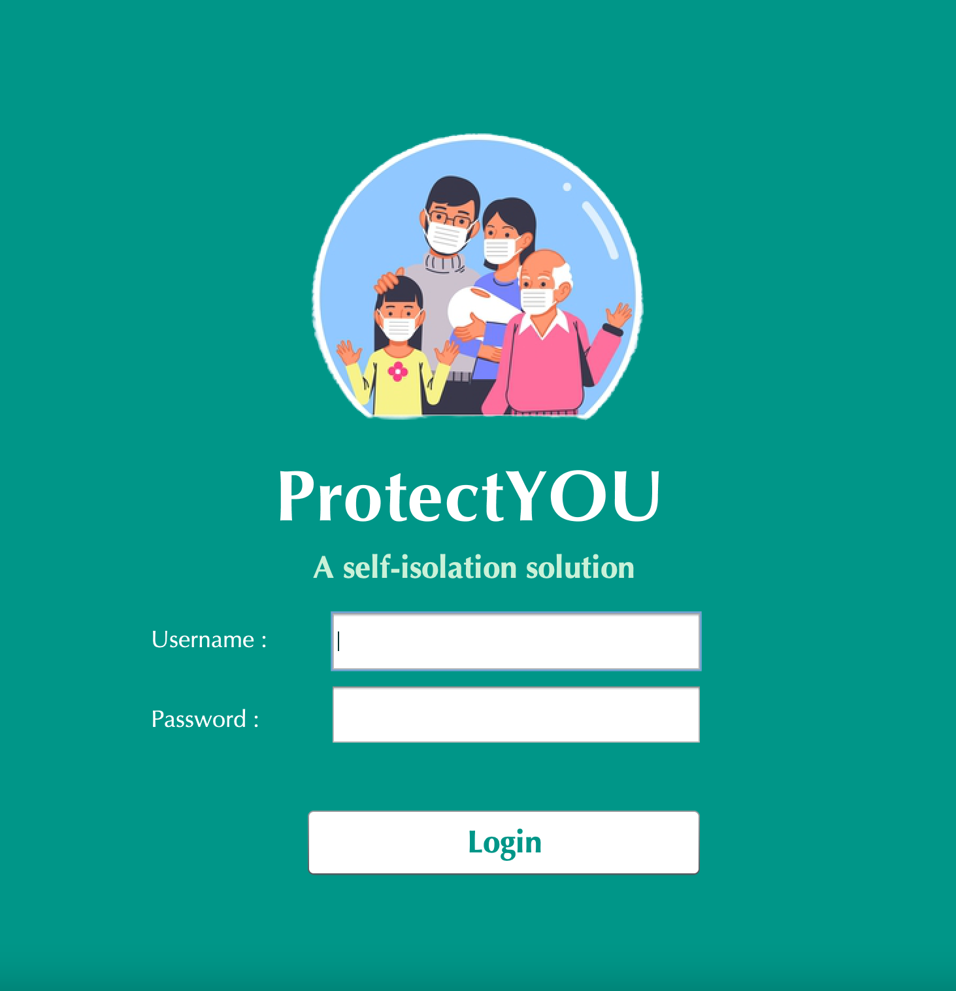
ADVANCED
FEATURES
Virtual Consultation Request via Zoom sent to Patient
Patient can generate PDF reports of Lab Results
Patient can generate PDF reports of Medicine Prescription
Patient uploads pictures of Daily Vitals monitor, and Nurse decodes them to Daily Vitals
Interactive charts to visualize patient history

Slide 5
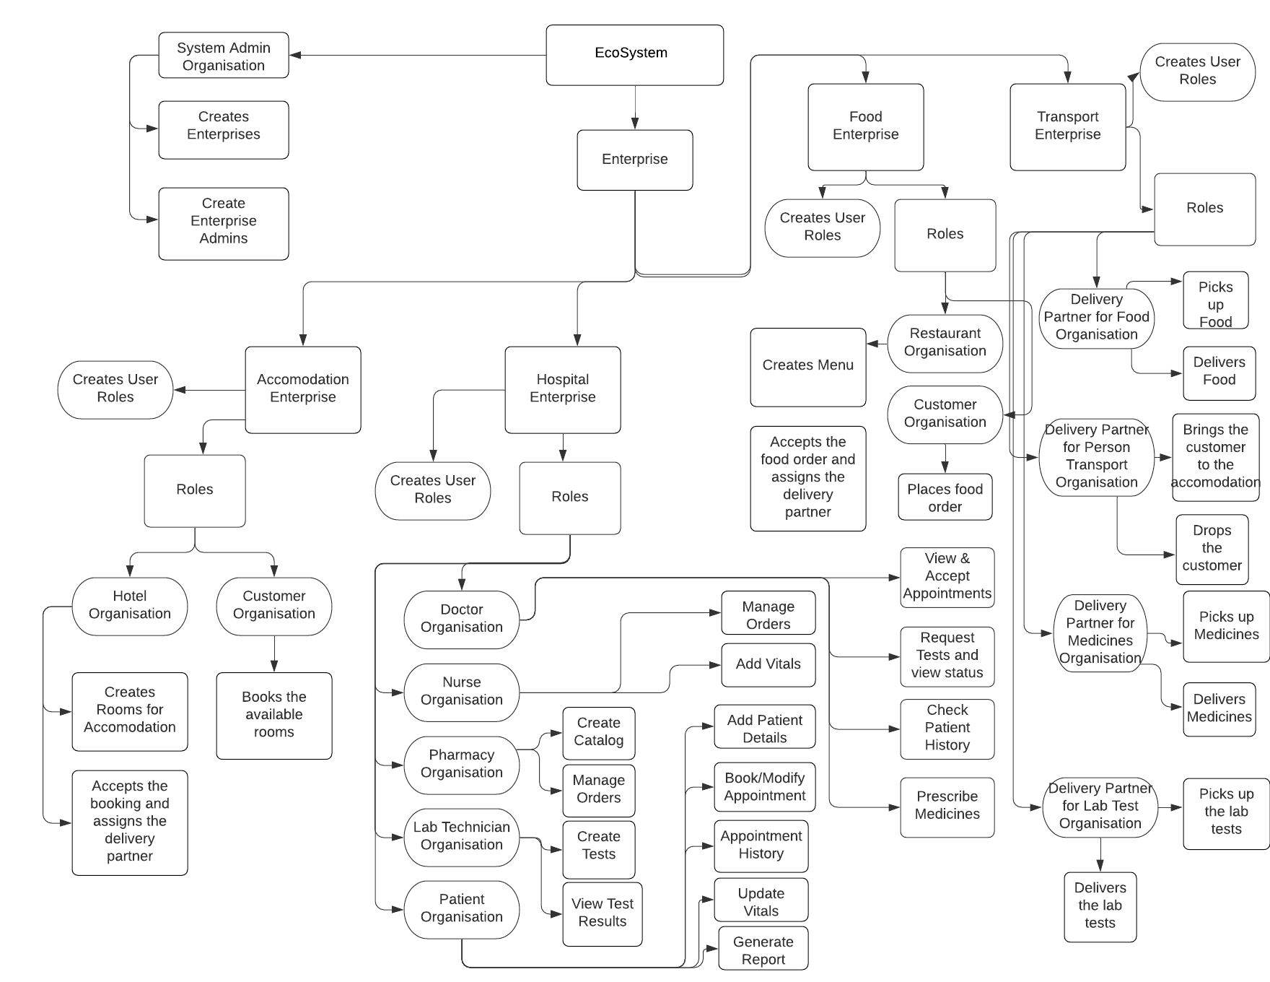
ARCHITECTURE
DIAGRAM

Slide 6
UML
CLASS DIAGRAM

Slide 7
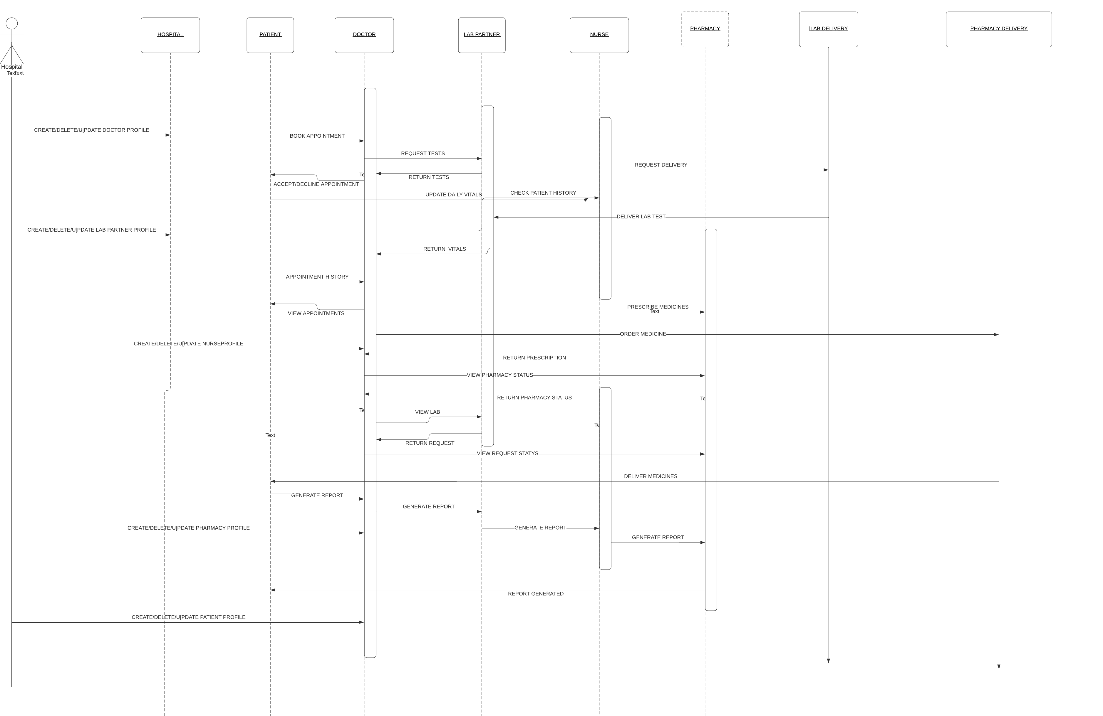
SEQUENCE
DIAGRAM
Hospital User

Slide 8
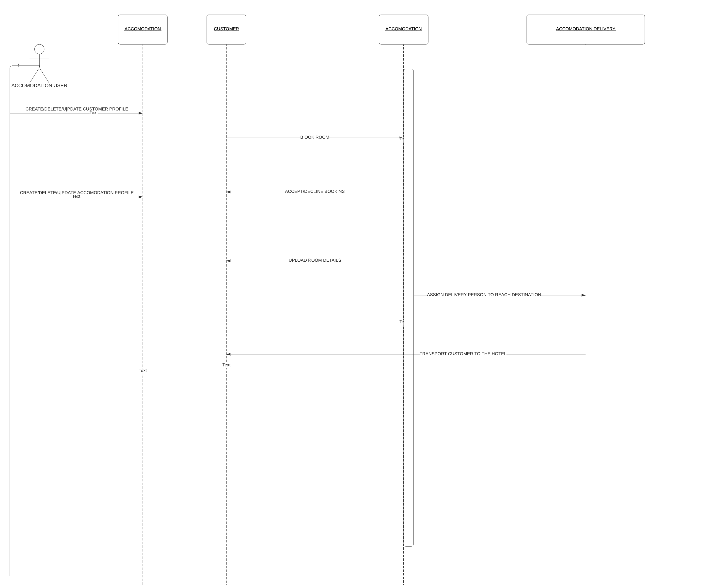
SEQUENCE
DIAGRAM
Accommodation
user

Slide 9
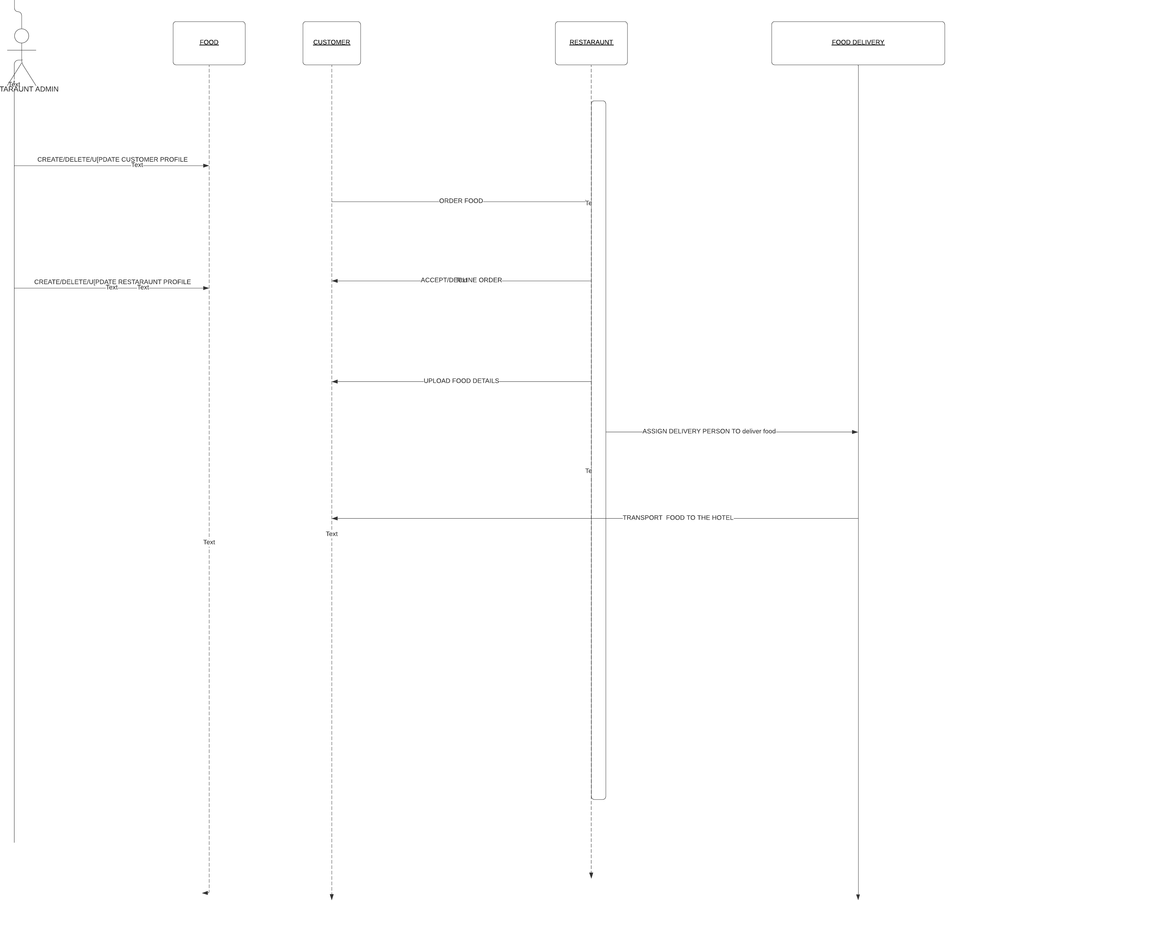
SEQUENCE
DIAGRAM
Food Order
User

Slide 10
KEY CAPABILITIES
1
2
3
Accommodation Booking with Options of Room, AC and Tariff
Contactless Food Ordering Service with options to choose from
Fully fledged on-demand healthcare portal with virtual consultation

Slide 11
KEY CAPABILITIES
4
Integrated transportation service for delivery of medicines, food, lab samples and transportation of patients.

Slide 12
ROLES and FUNCTIONS
PHARMACY ROLE
DOCTOR ROLE
LAB ROLE
NURSE ROLE
The Pharmacy Role login can create Product Catalog, specify price and set stock of each item.
They can also set up transport for medicines to patients.
Doctor role can accept appointment requests and send SMS to patient to set up zoom appointment. Doctor can request for Tests, place prescription requests and view patient vitals history. Additionally, Doctor can view status of lab requests and medicine requests.
Lab role can set up available test catalogs and prices. They can also set up transport for medicines to patients.
Nurse can view the daily vital images and update the daily vitals of each patient.

Slide 13




ROLES and FUNCTION
ACCOMMODATION ADMIN ROLE
FOOD SYSTEM ROLE
LAB TRANSPORT ROLE
FOOD TRANSPORT ROLE
Accommodation Admin can create and put-up rooms for renting, set up tariffs and room types.
Food System Admin can create and upload menus, set prices and modify and accept orders from customers.
Lab transport partner can see all Lab Requests and can collect sample from customer and submit it to labs for analysis.
Food Transport partner sees ready for delivery food orders and delivers it to Customer’s address contactlessly.

Slide 14




ROLES and FUNCTION
SYSTEM ADMINISTRATOR ROLE
PATIENT TRANSPORT
MEDICINE TRANSPORT ROLE
PATIENT/CUSTOMER ROLE
System Administrator creates Enterprises and respective Enterprise Admins.
Patient Transport partner picks up patient from their address and drops them to the booked quarantine facility in an ambulance.
Medicine transport partner can see all delivery requests from pharmacies and can deliver them to customer.
Customers can book accommodation and make food orders. Additionally, if they are a patient and avails the healthcare portal, they can book appointments, upload daily vitals and see trends. They can also generate medical reports.

Slide 15
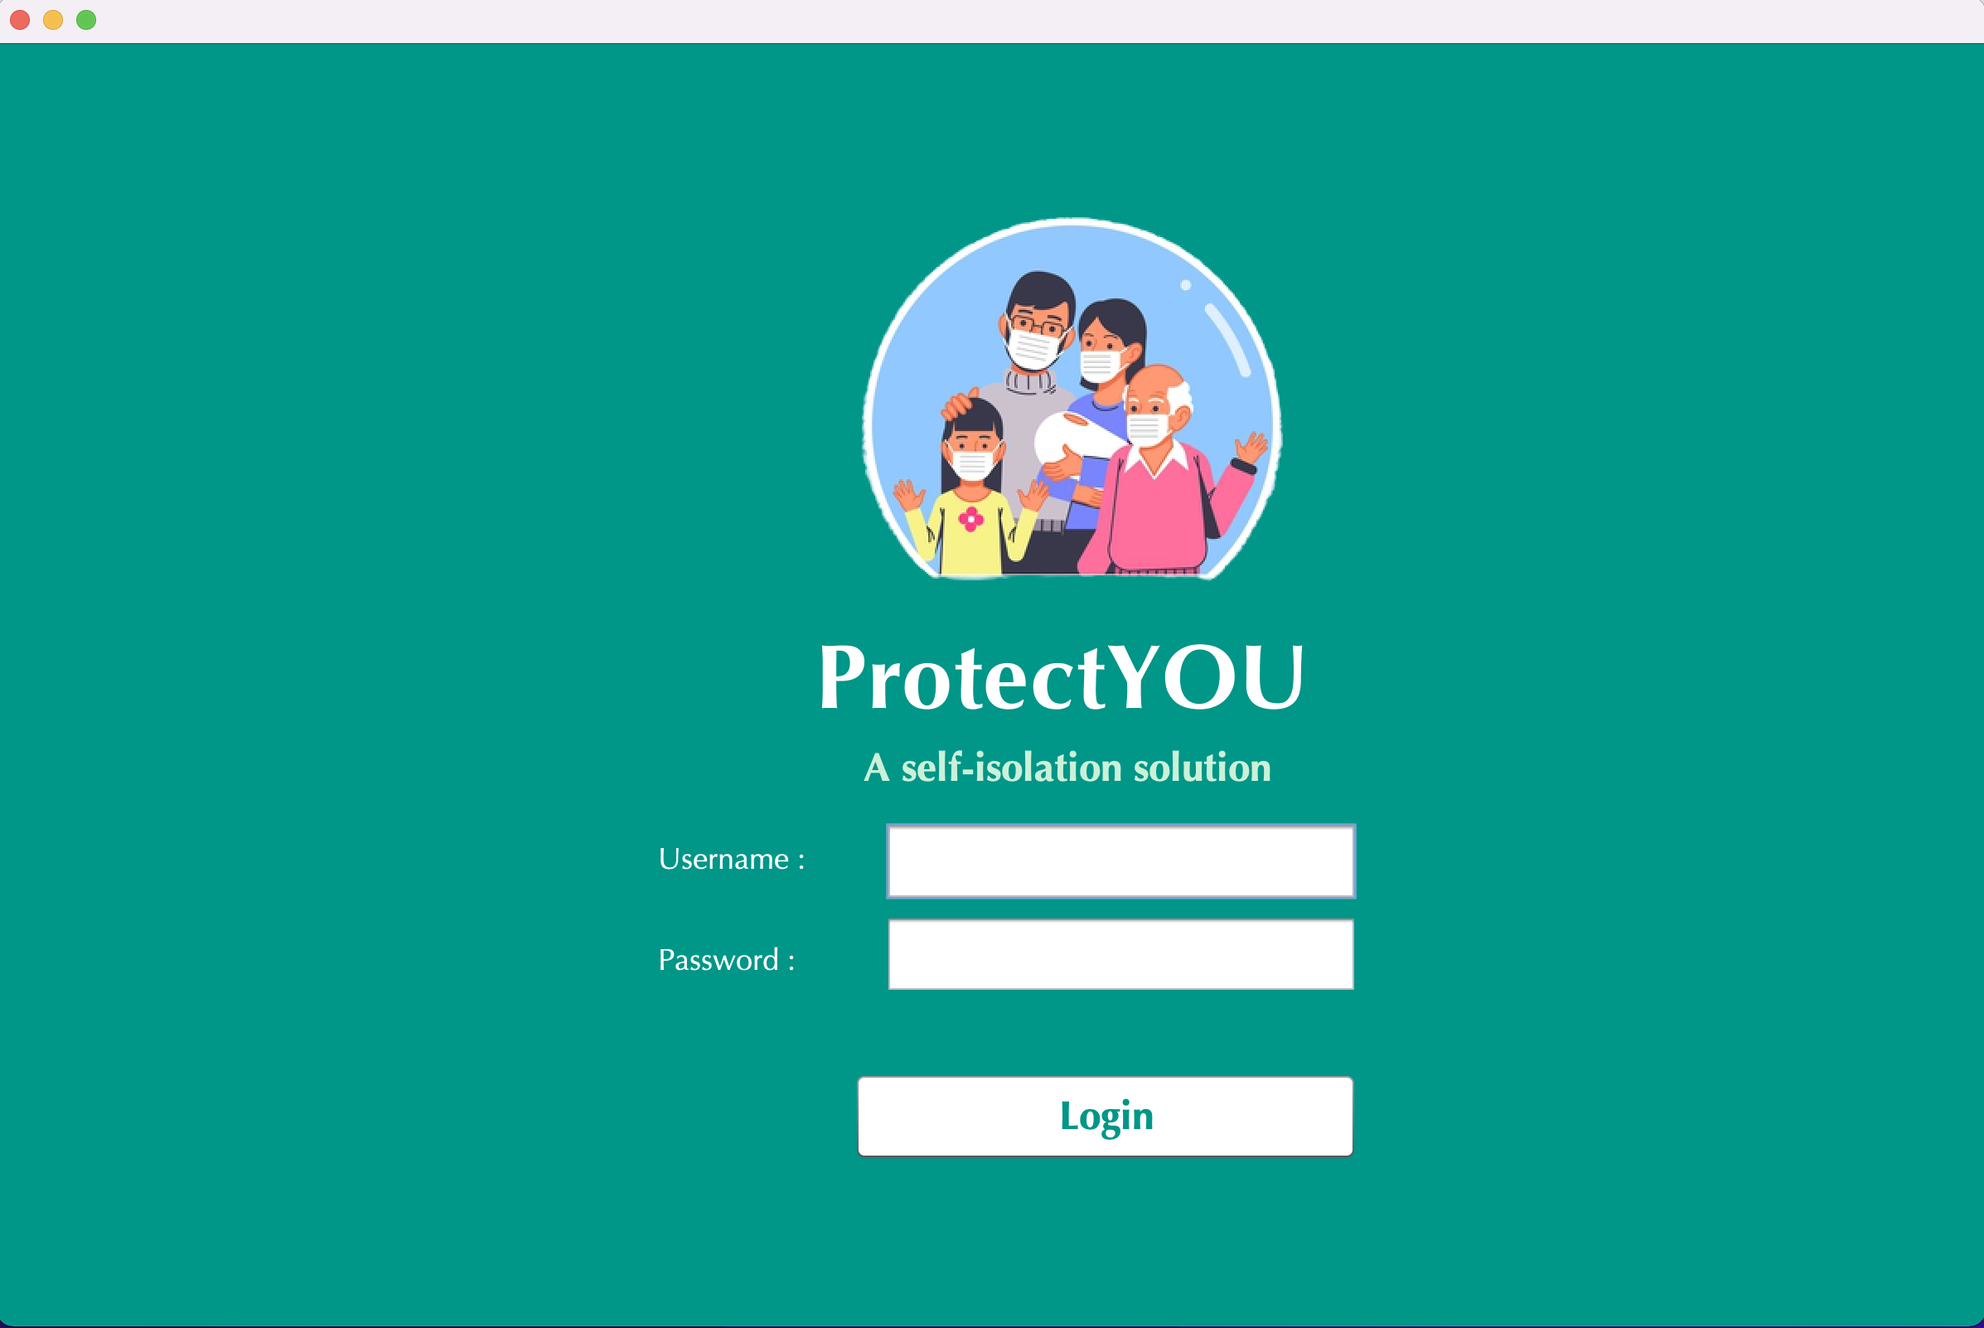
USER INTERFACE
SCREENSHOTS

Slide 16
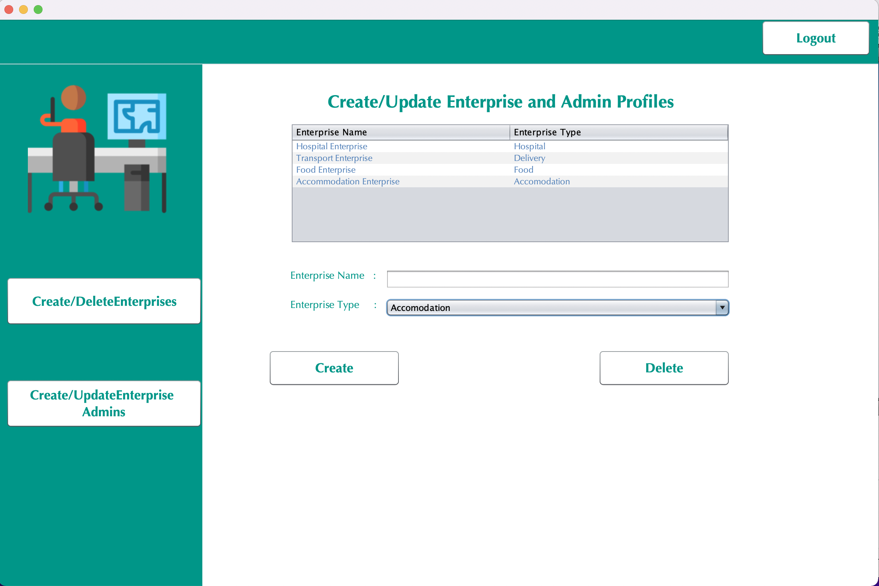

Slide 17
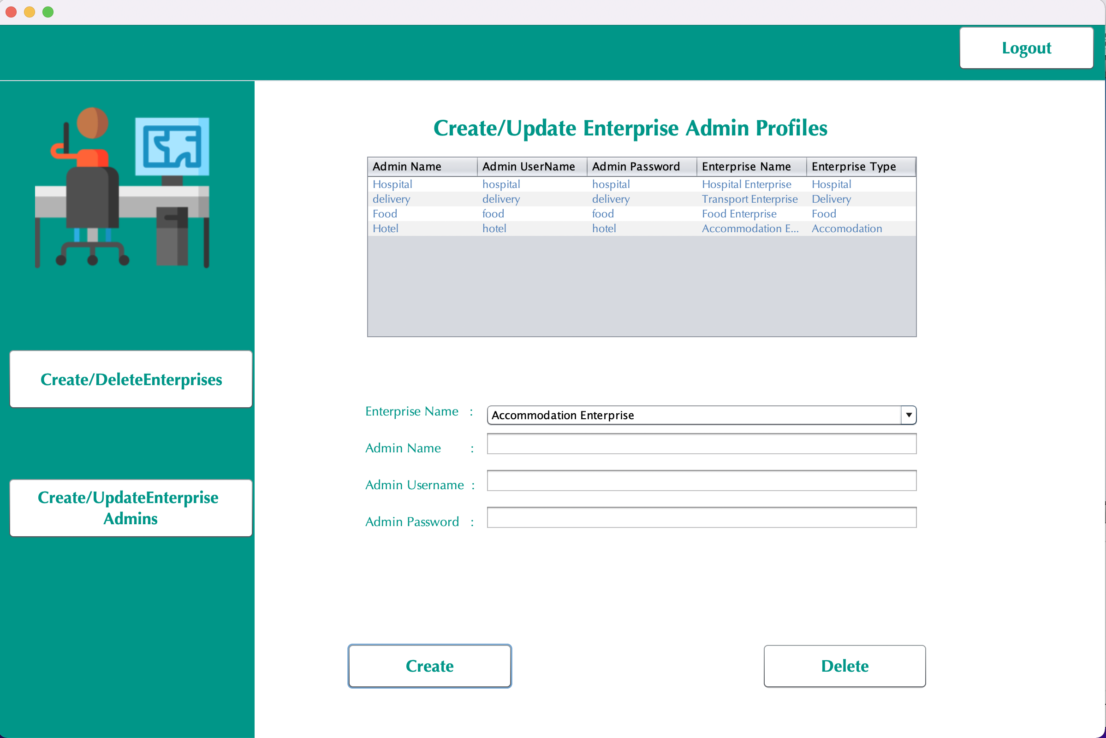

Slide 18
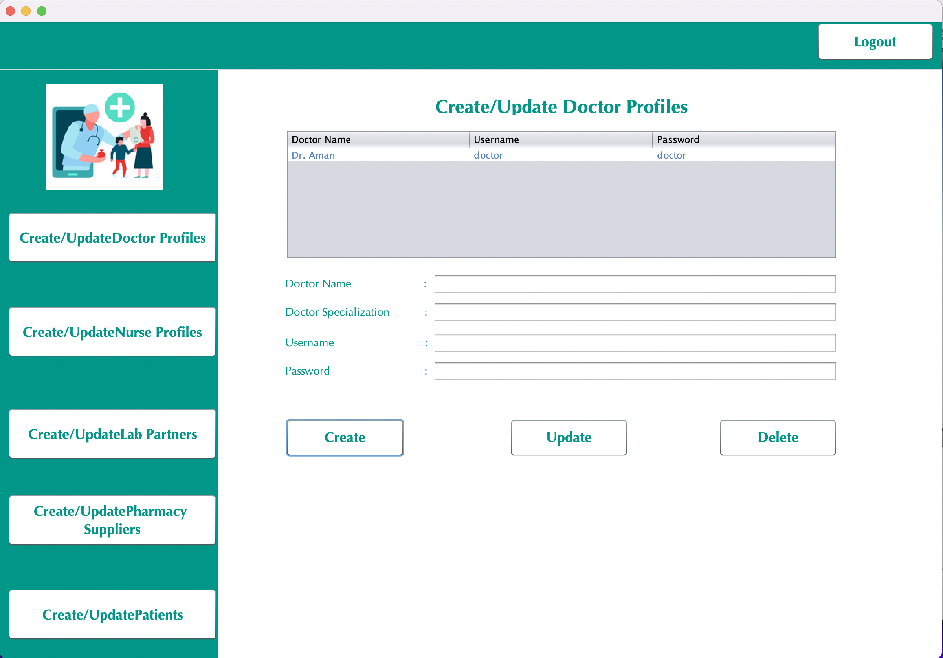

Slide 19
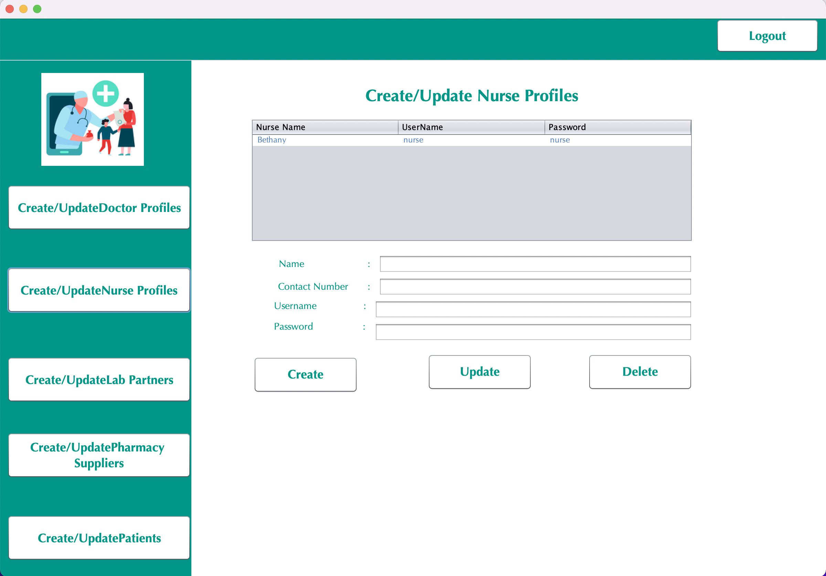

Slide 20
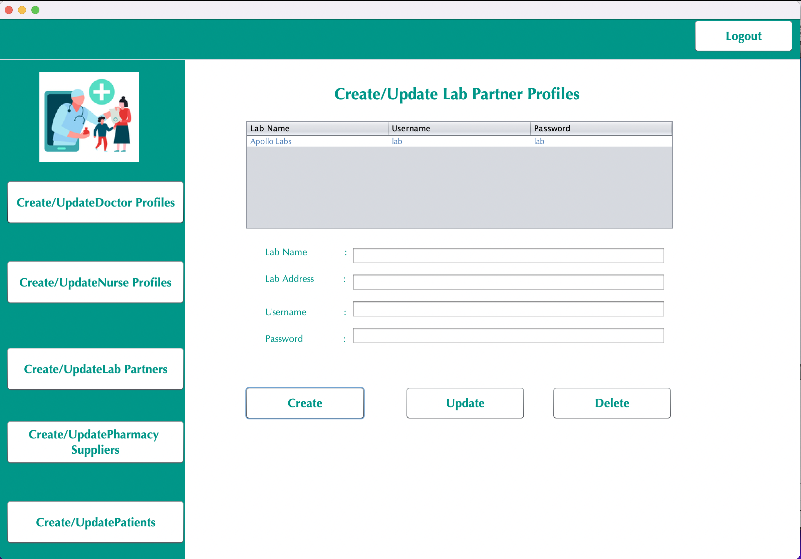

Slide 21
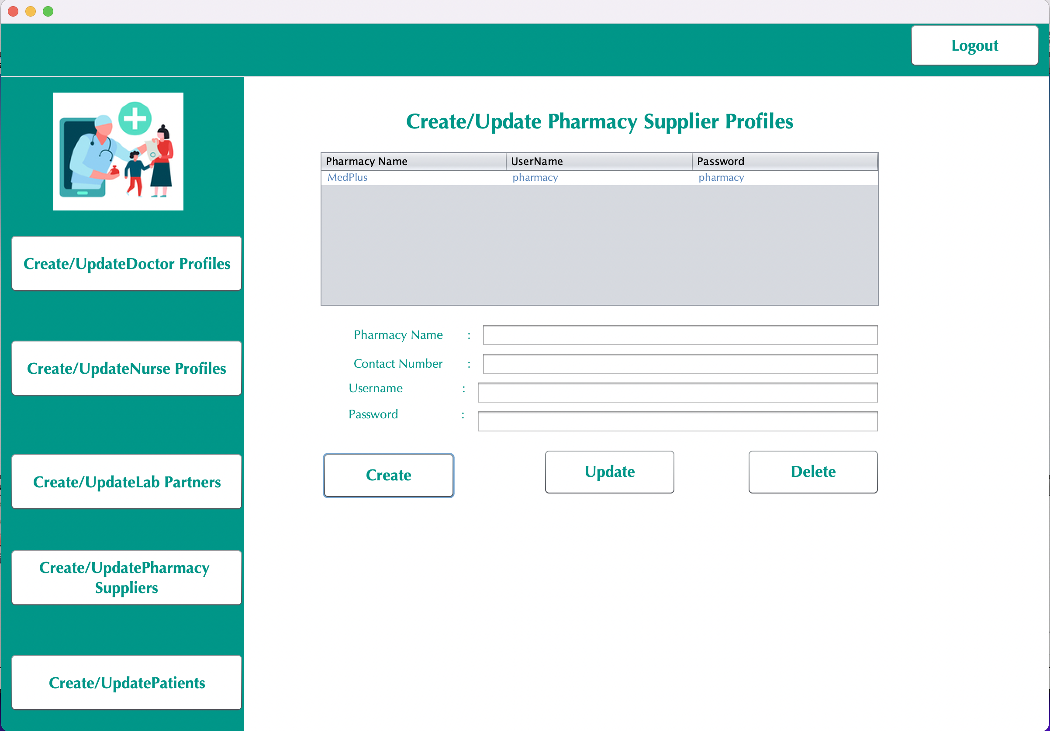

Slide 22
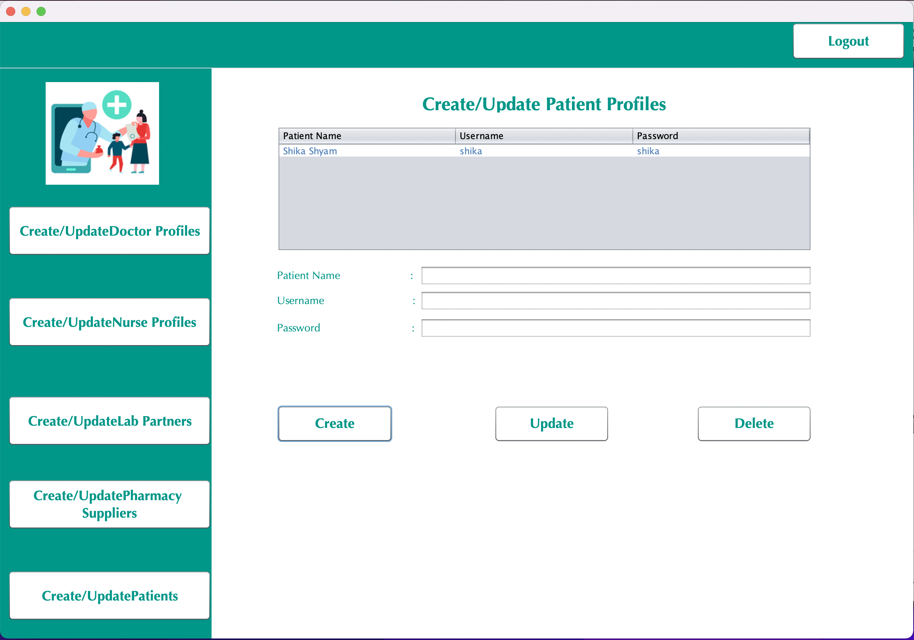

Slide 23
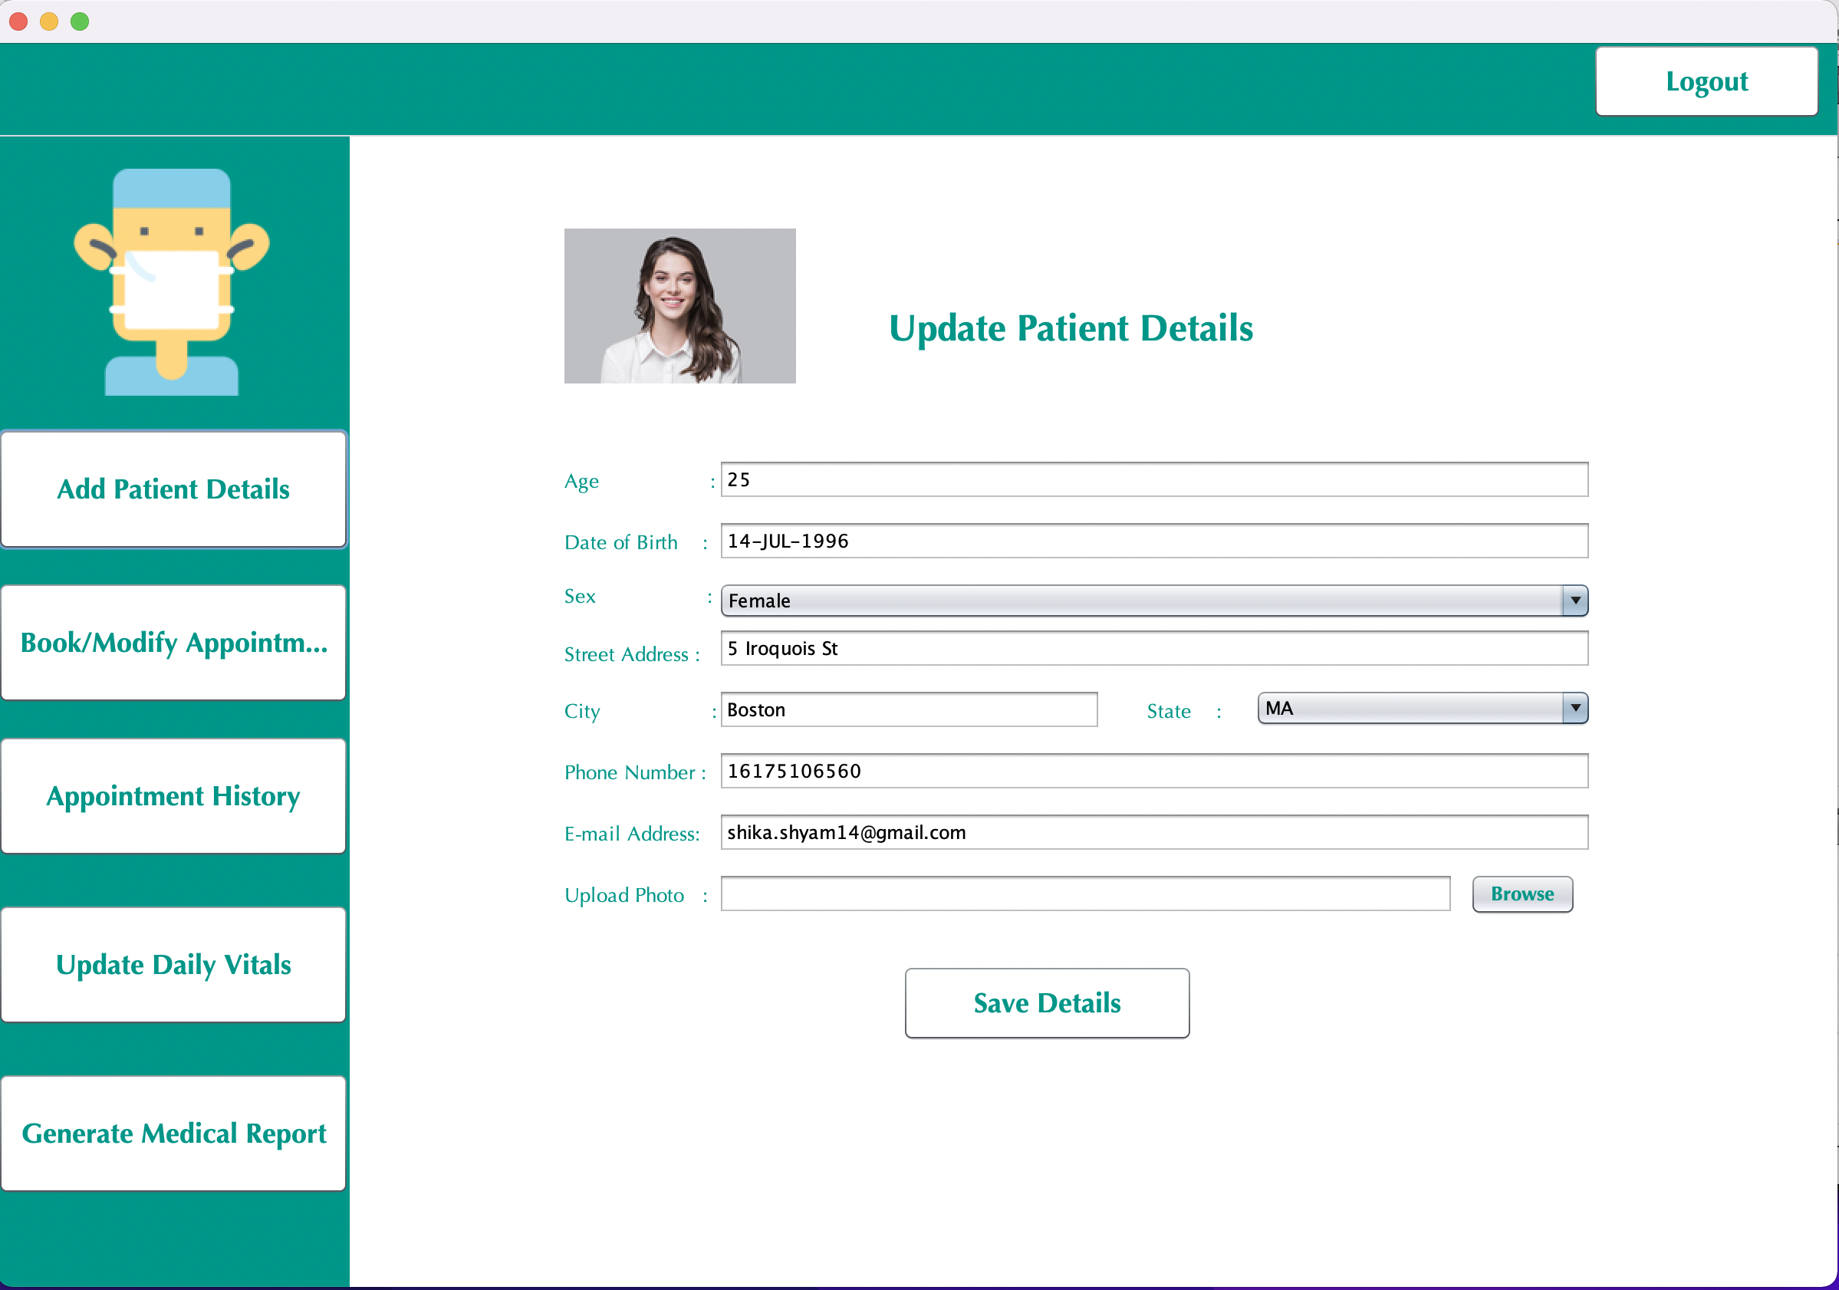

Slide 24
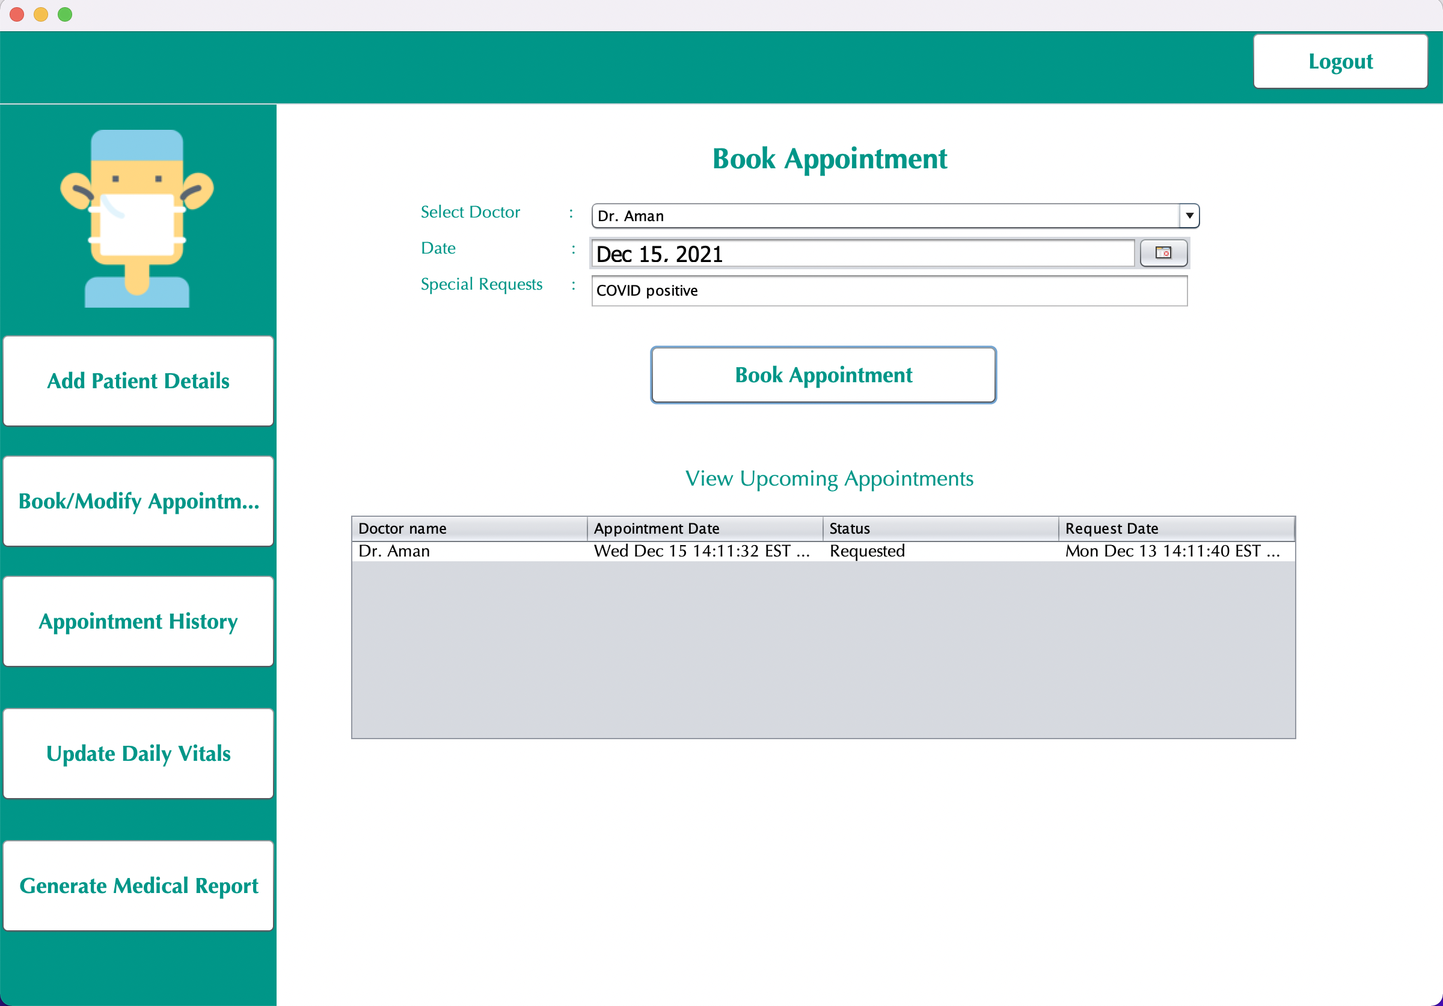

Slide 25
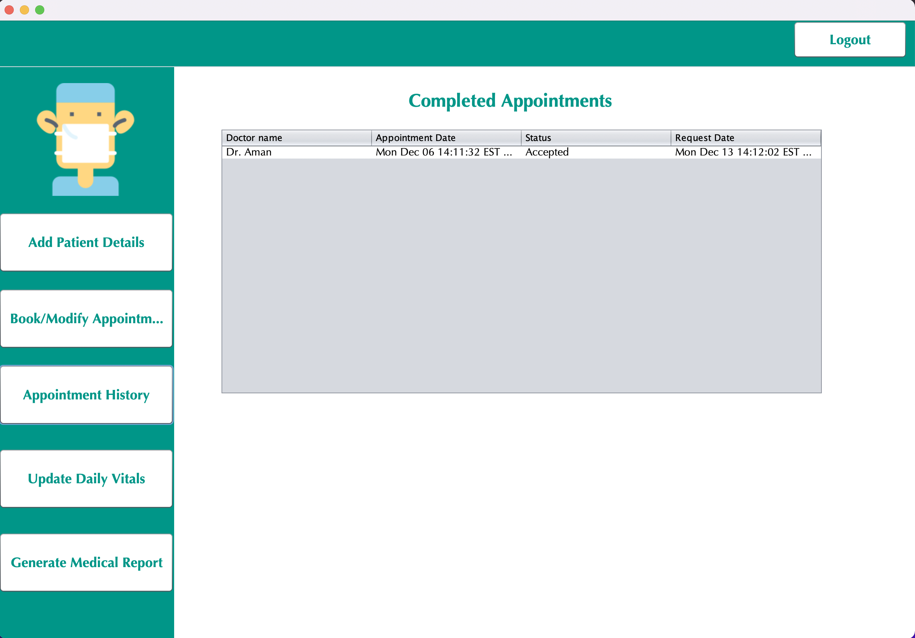

Slide 26
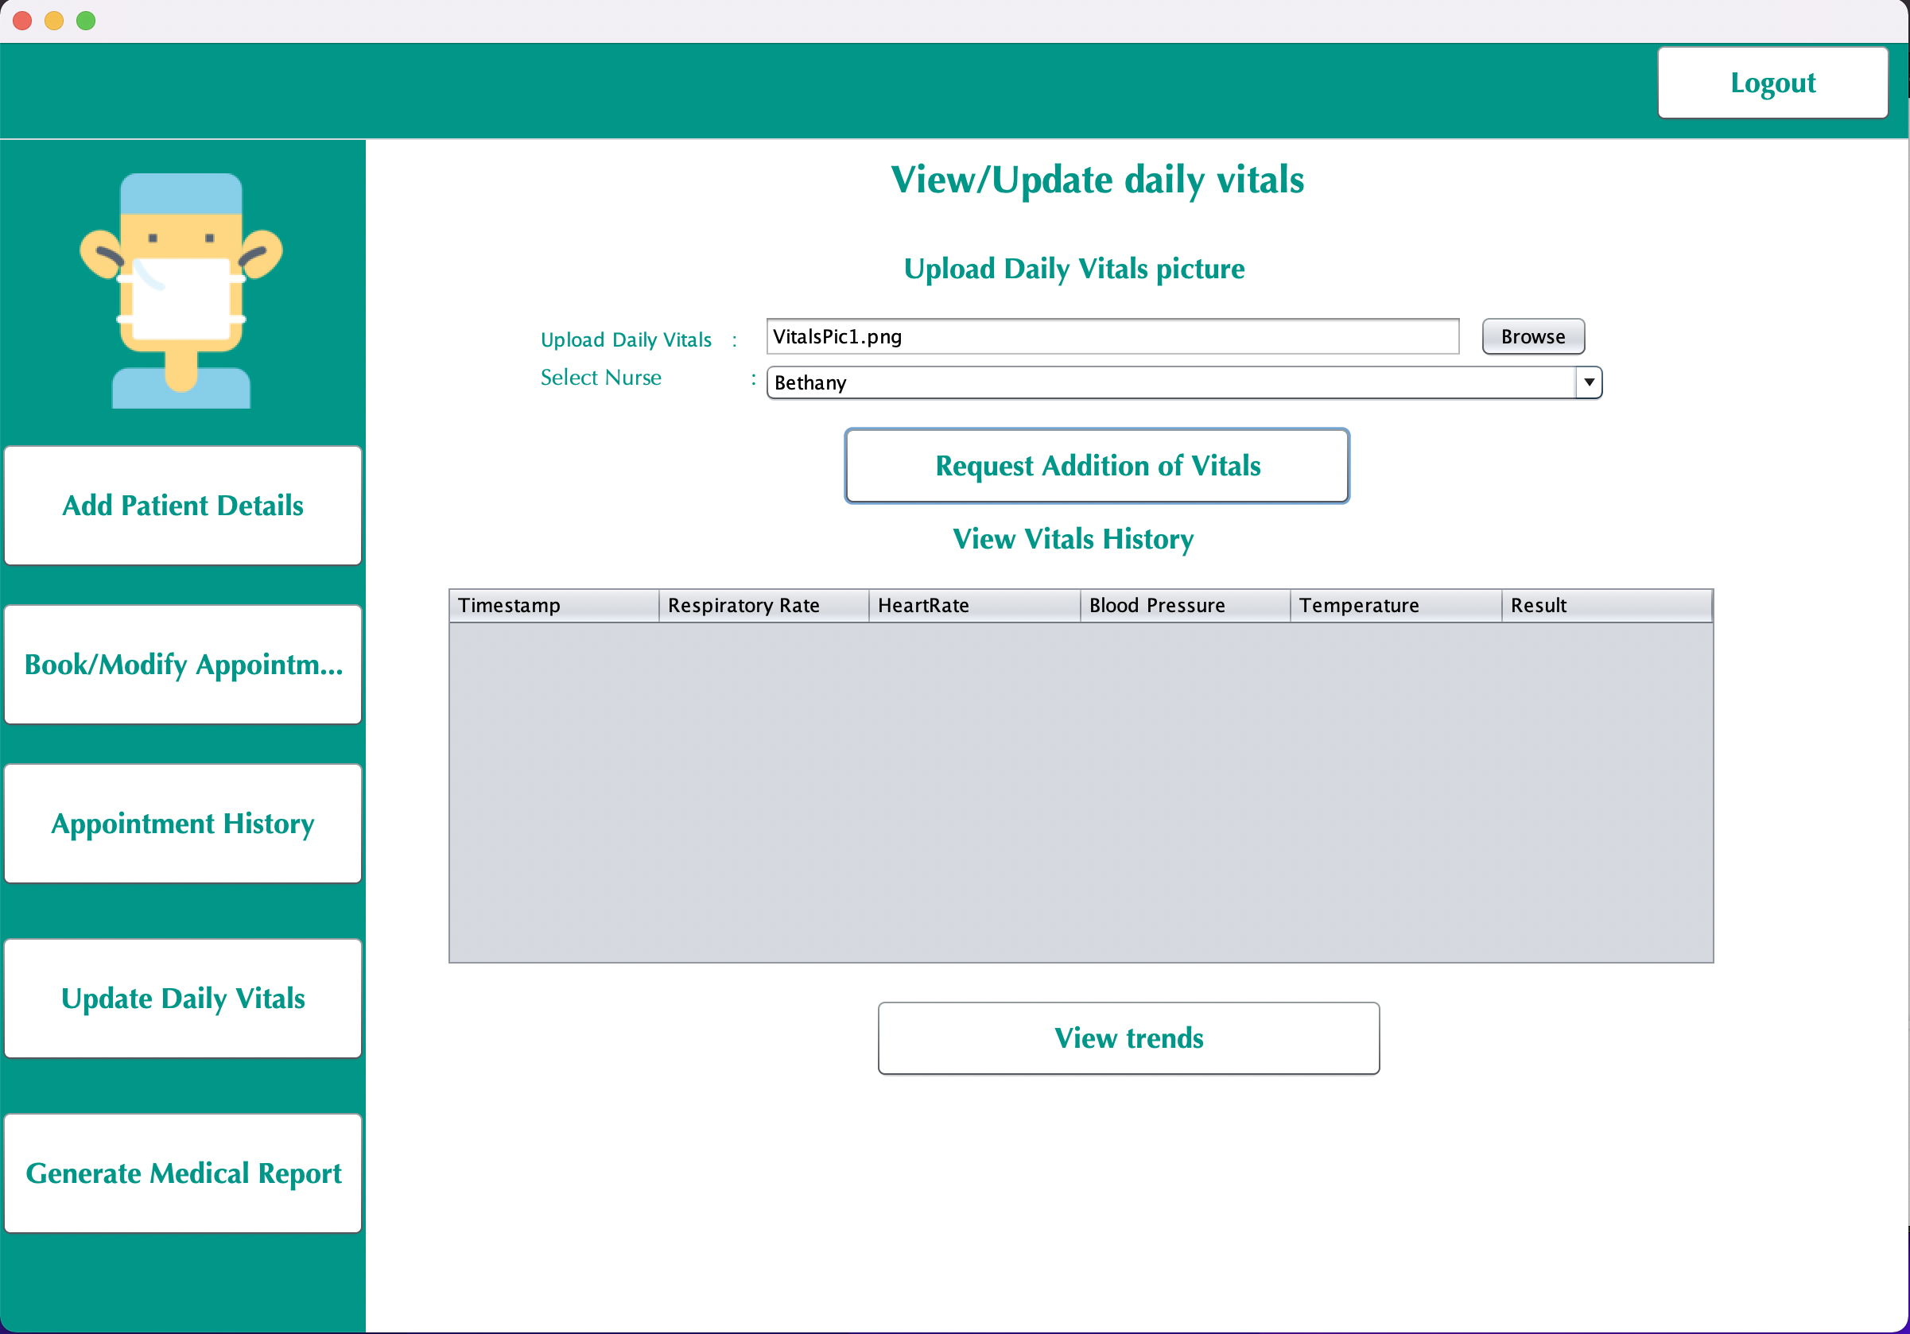

Slide 27
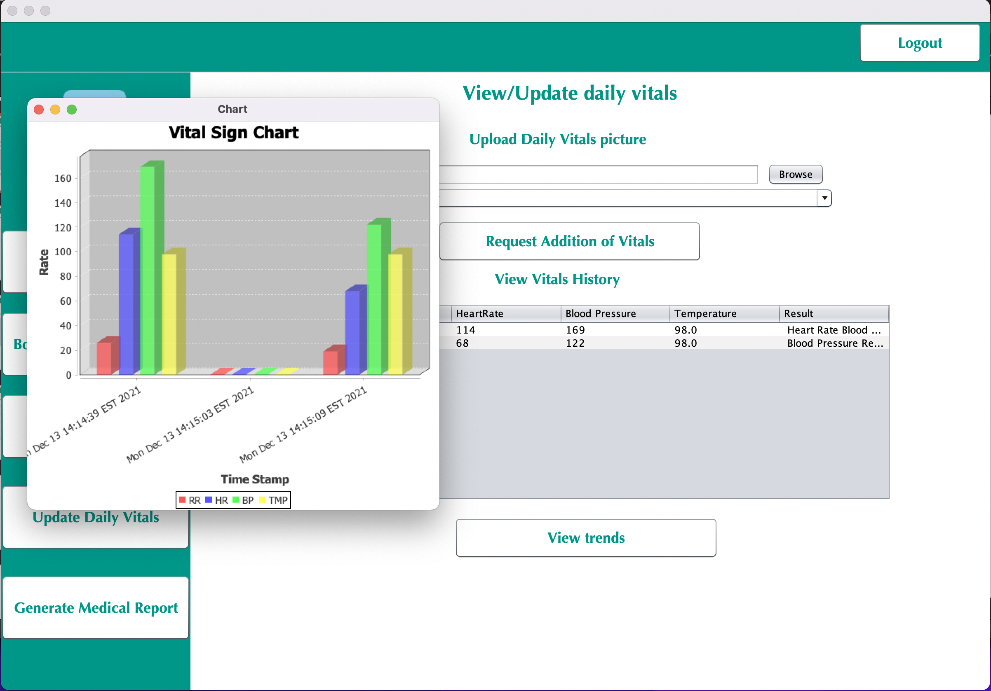

Slide 28
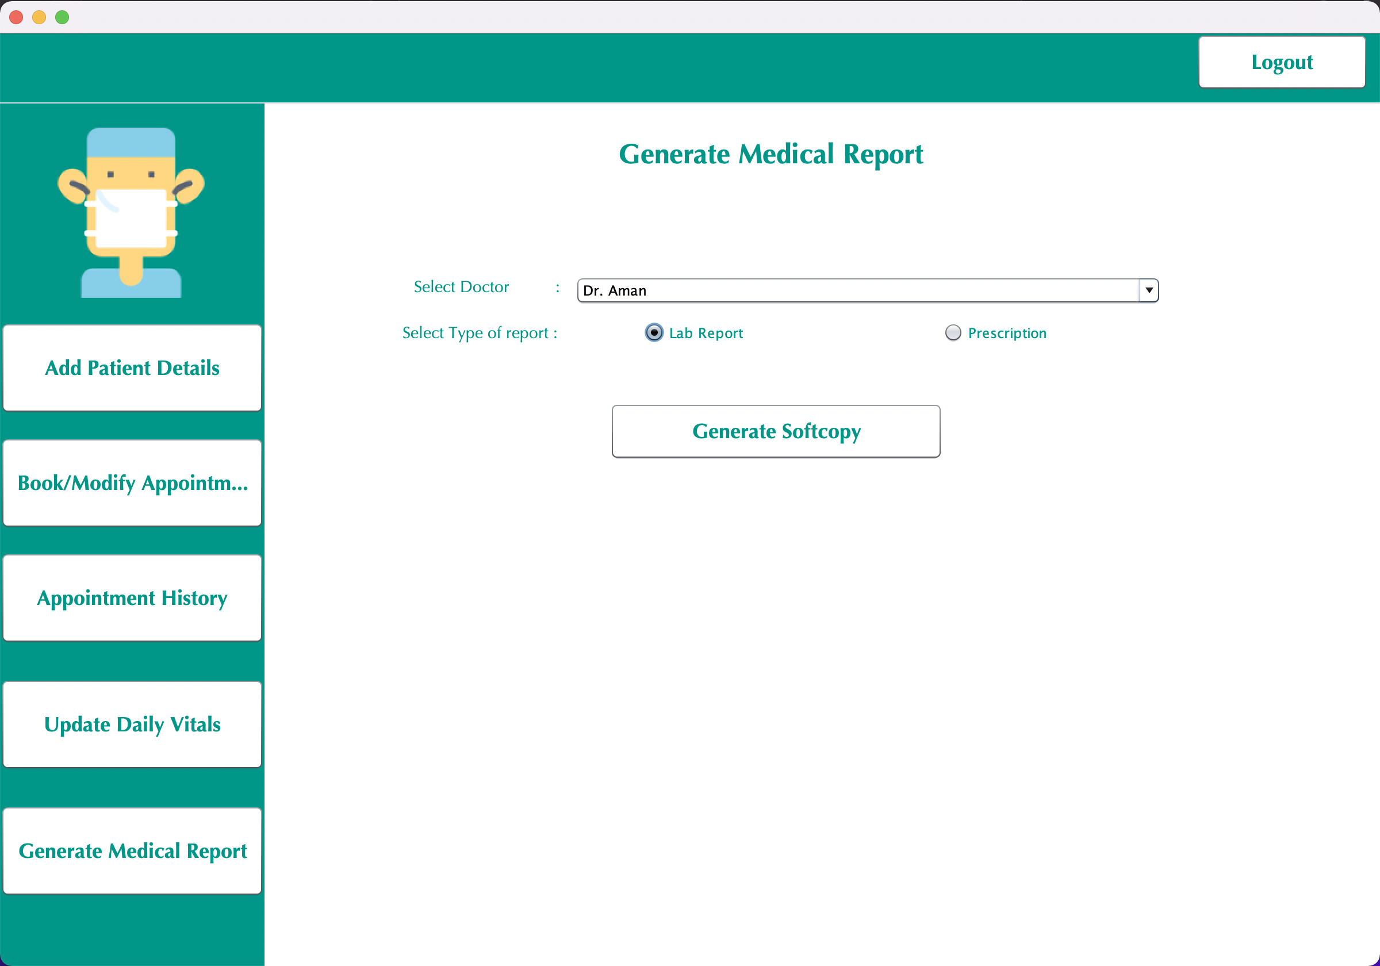

Slide 29
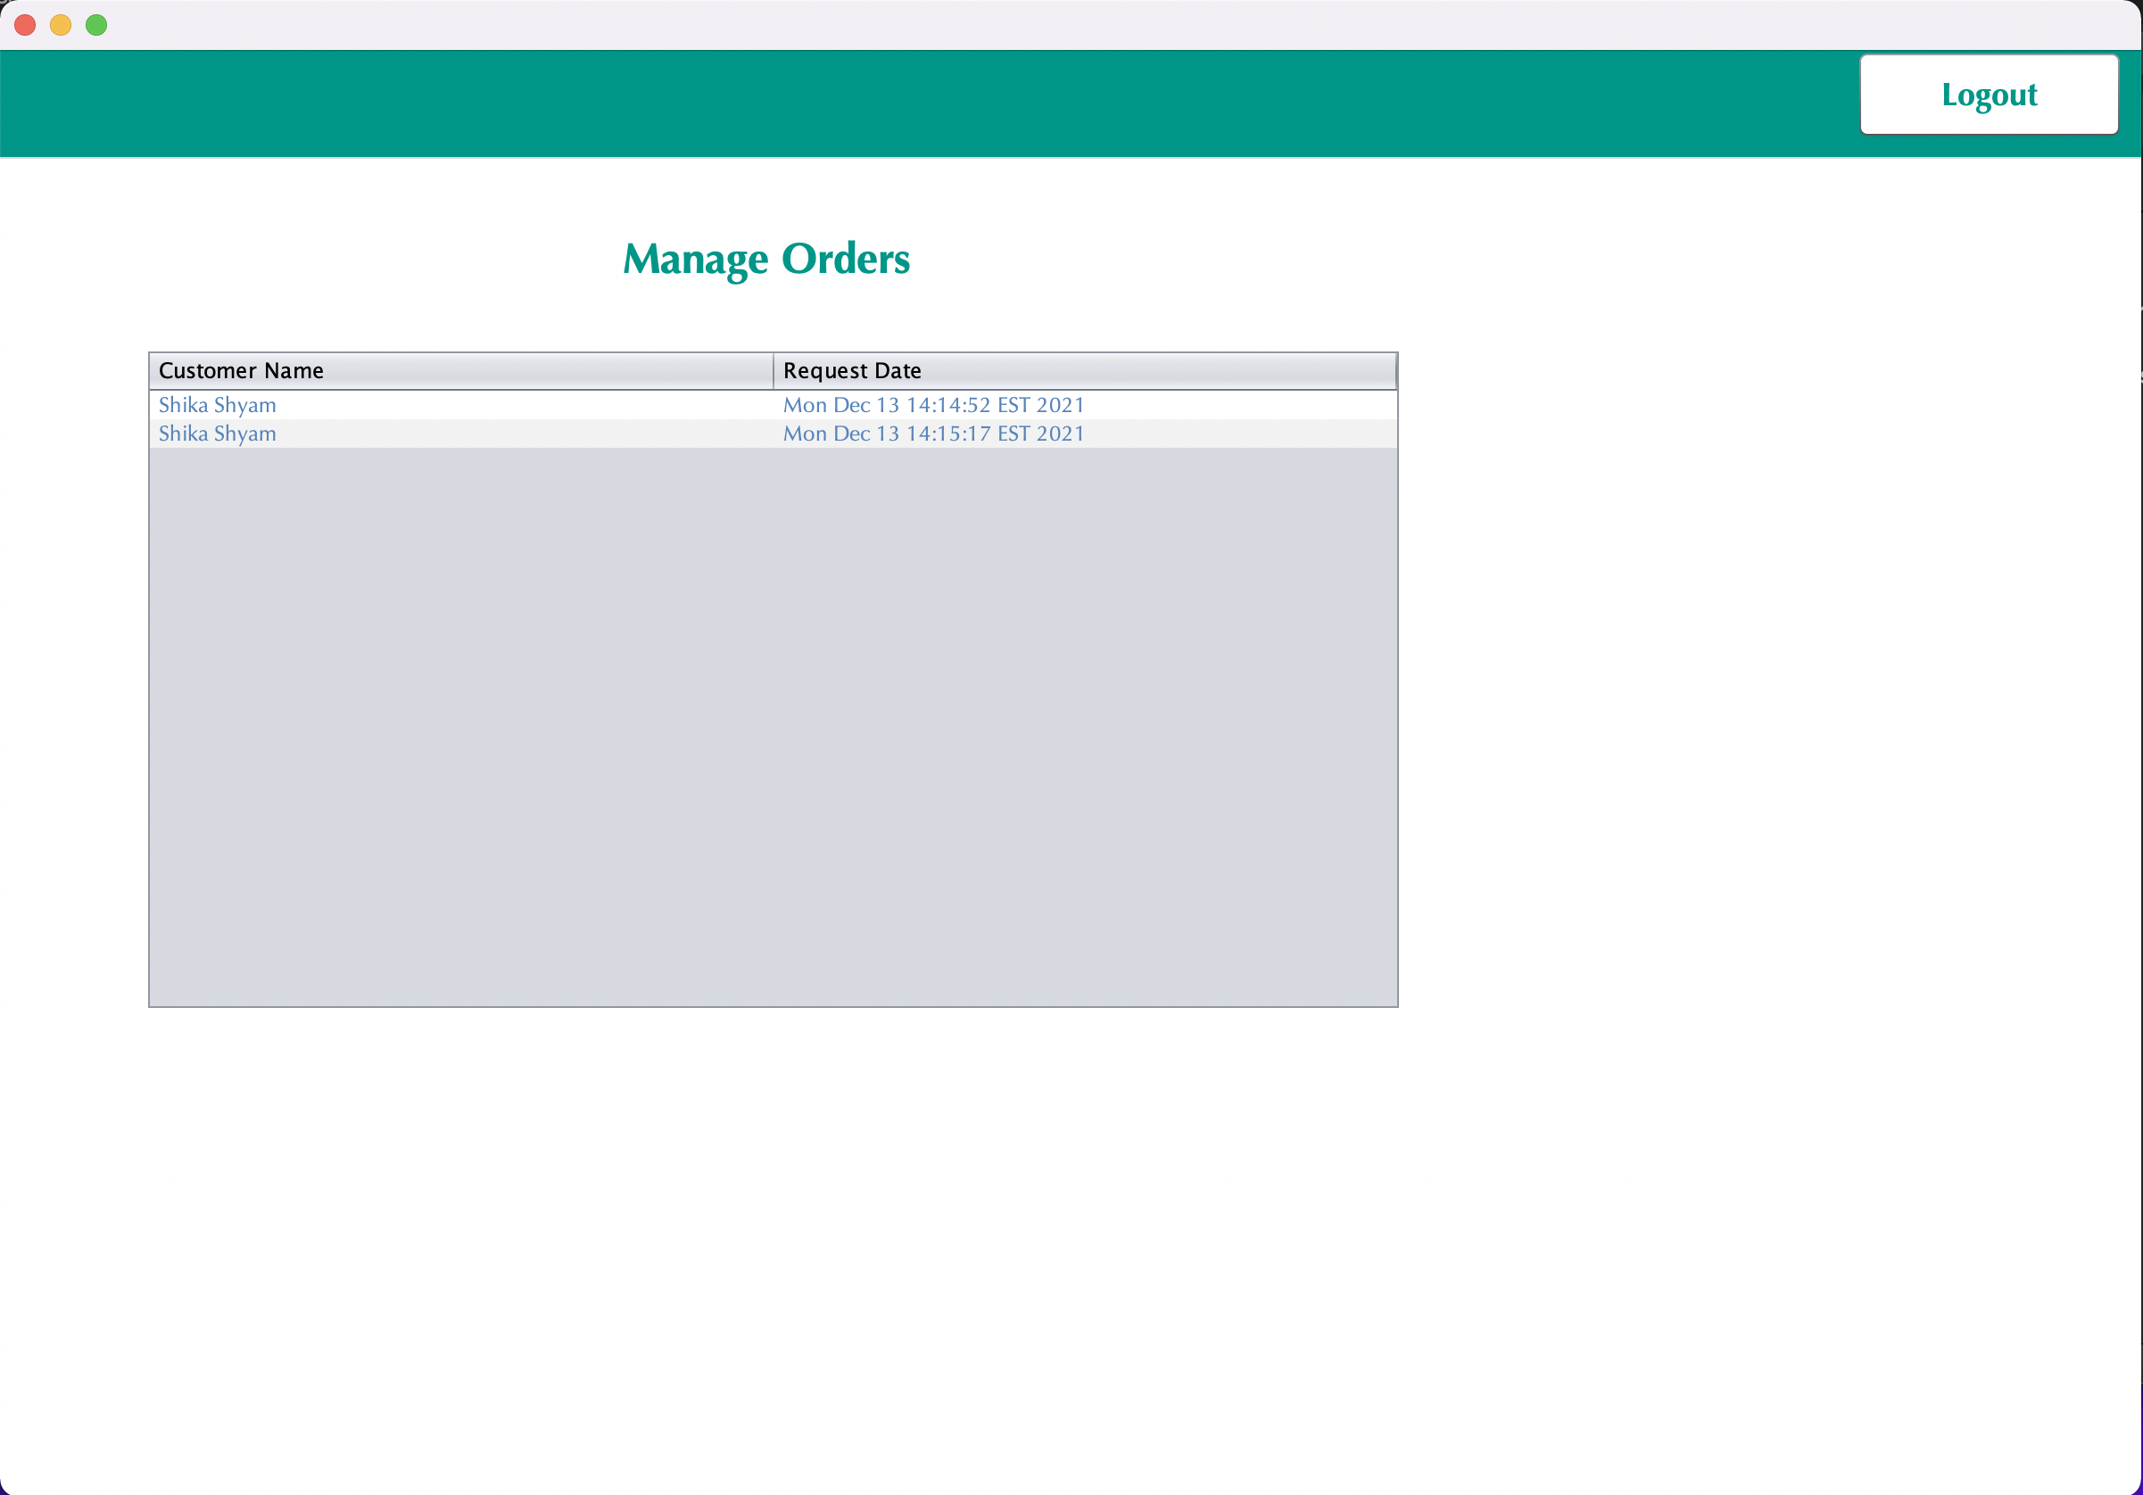

Slide 30
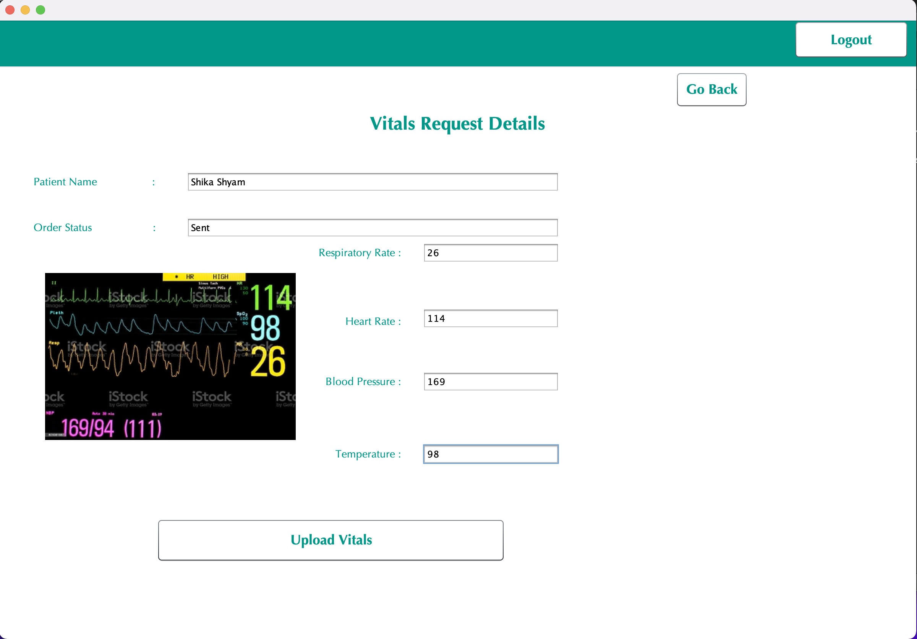

Slide 31
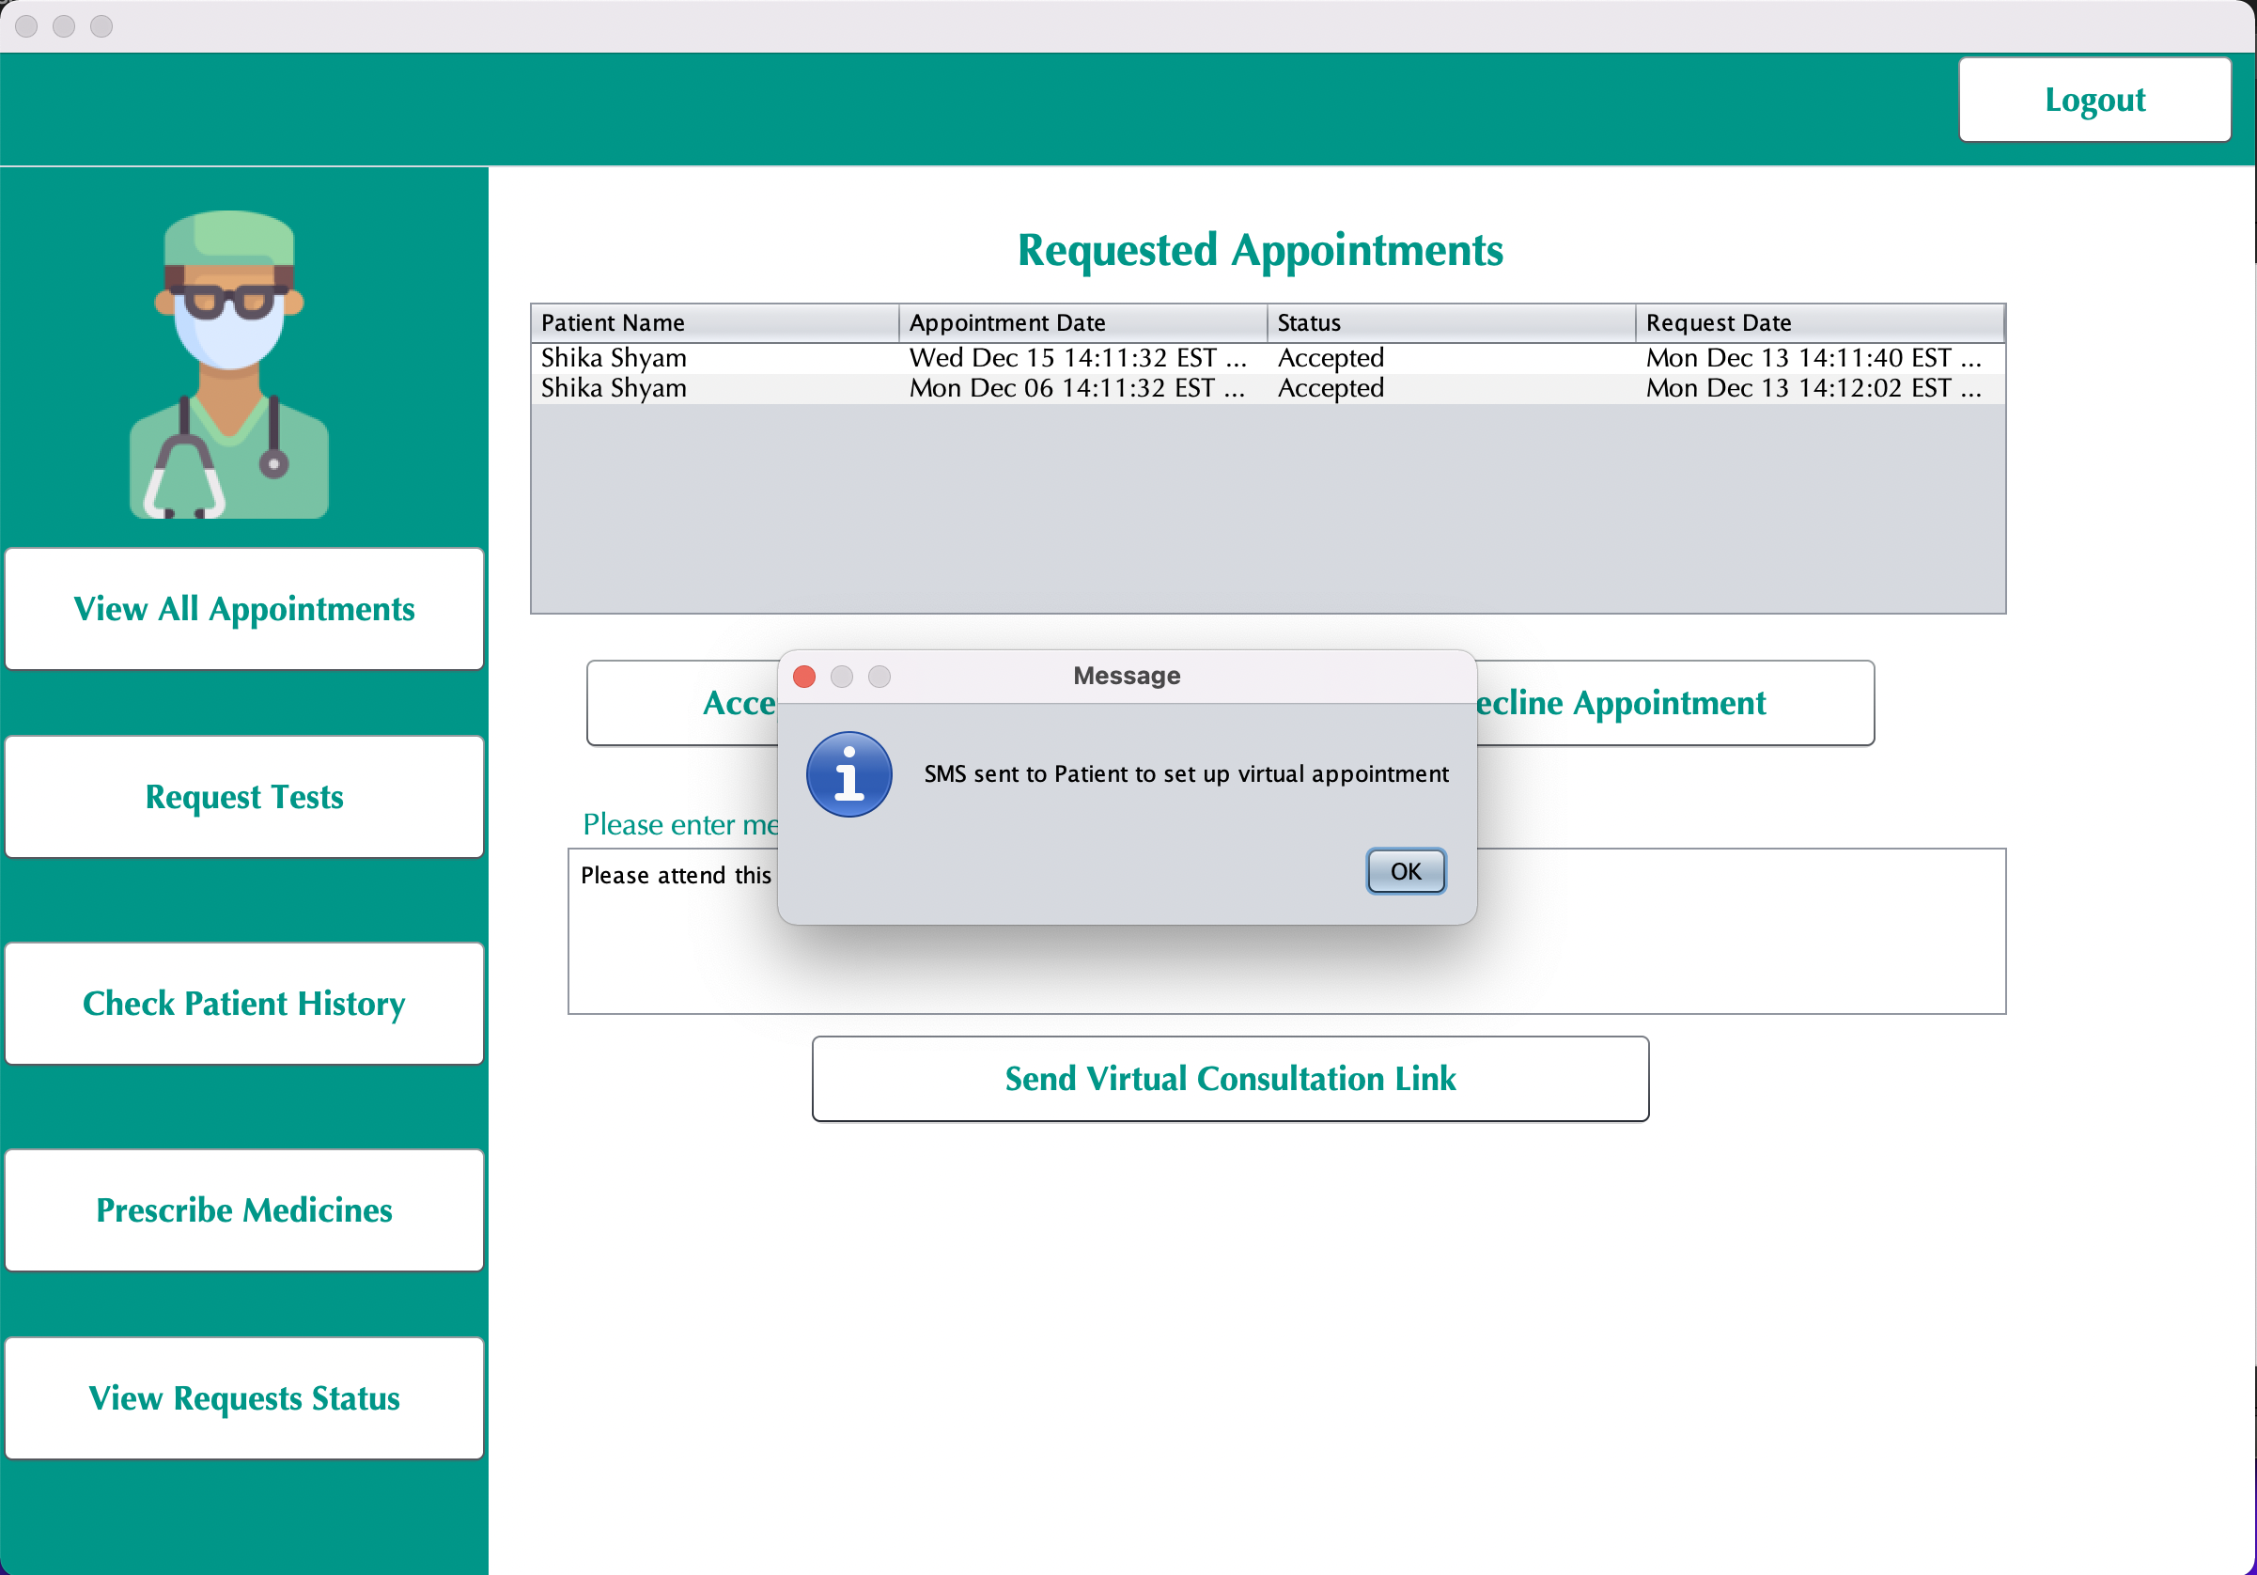

Slide 32
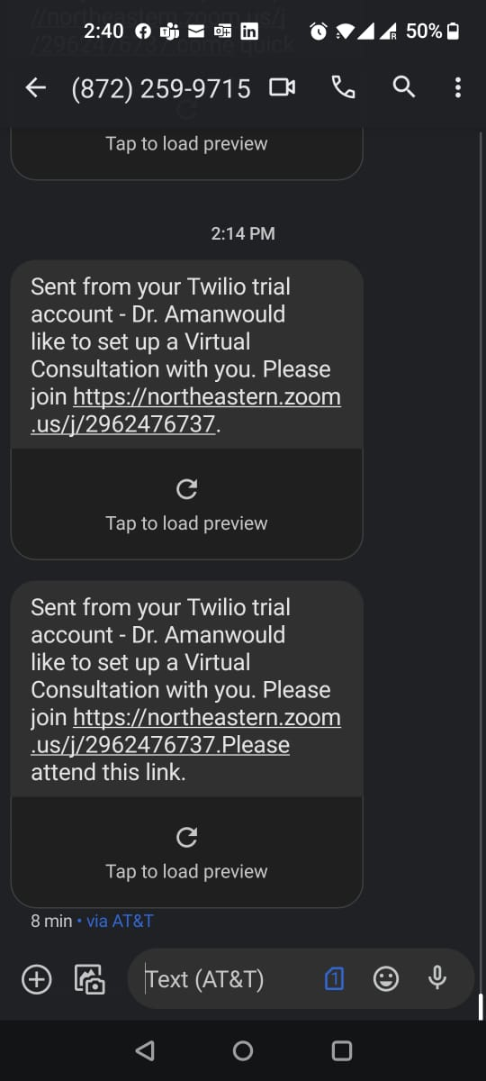

Slide 33
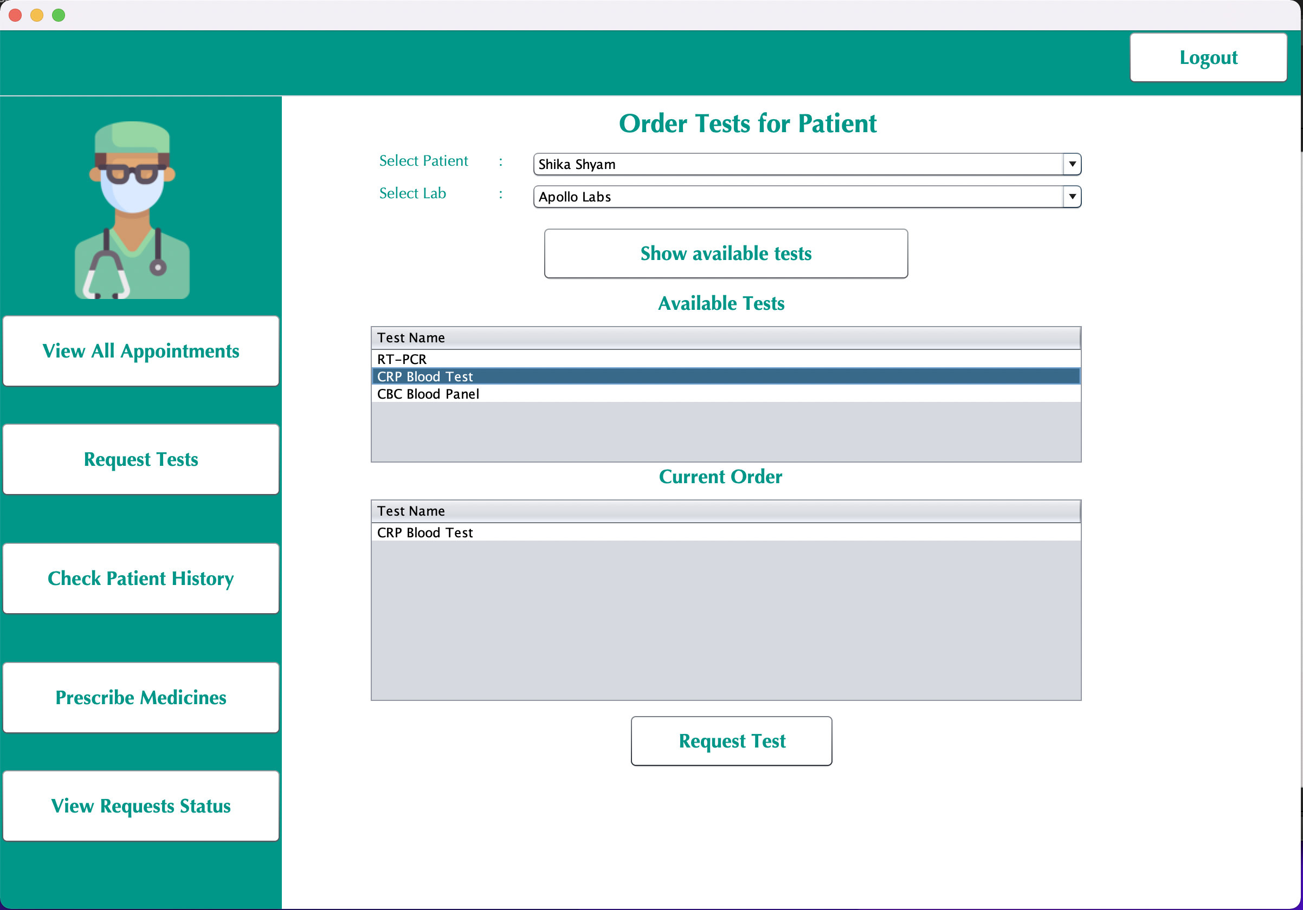

Slide 34
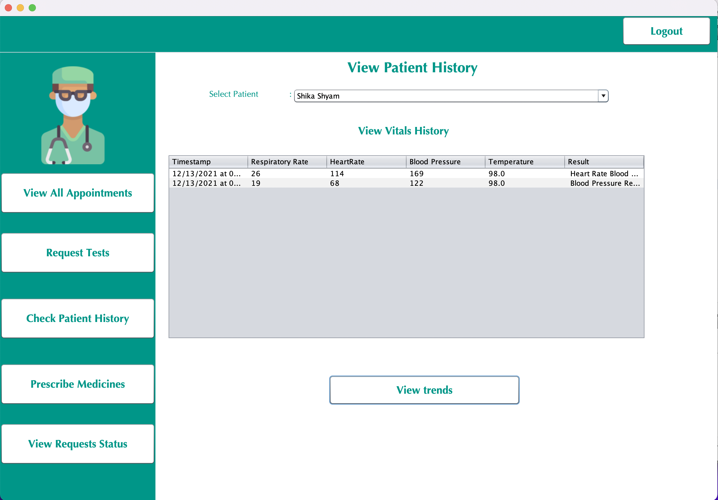

Slide 35
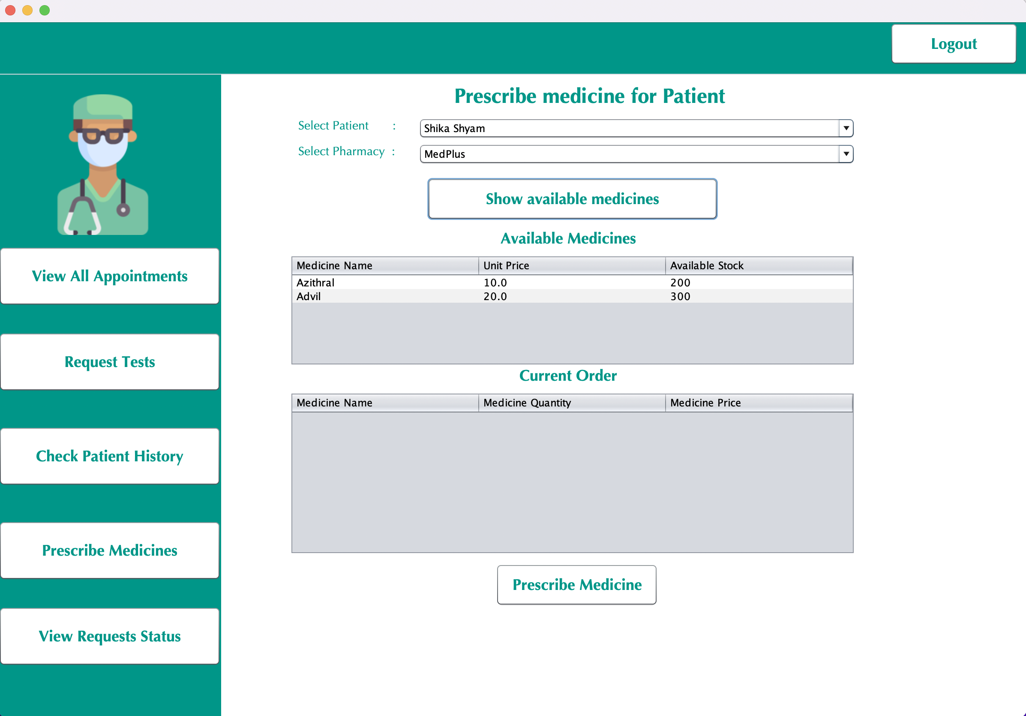

Slide 36
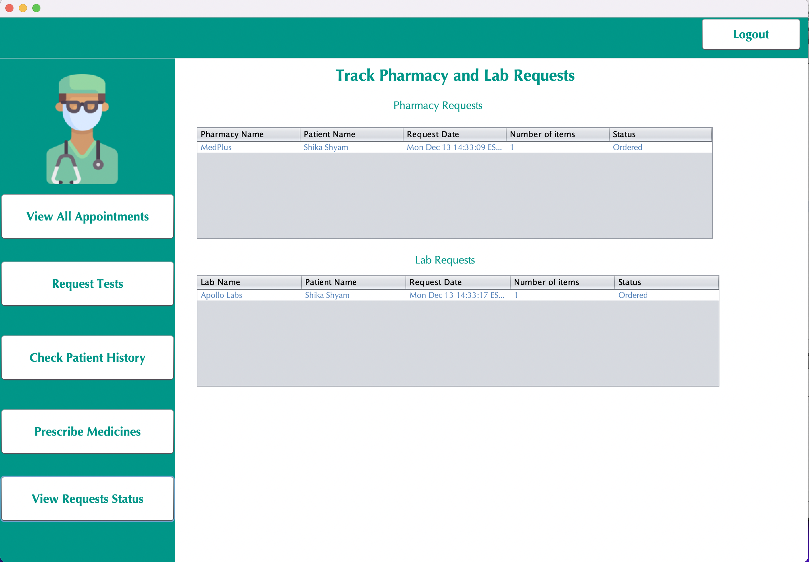

Slide 37
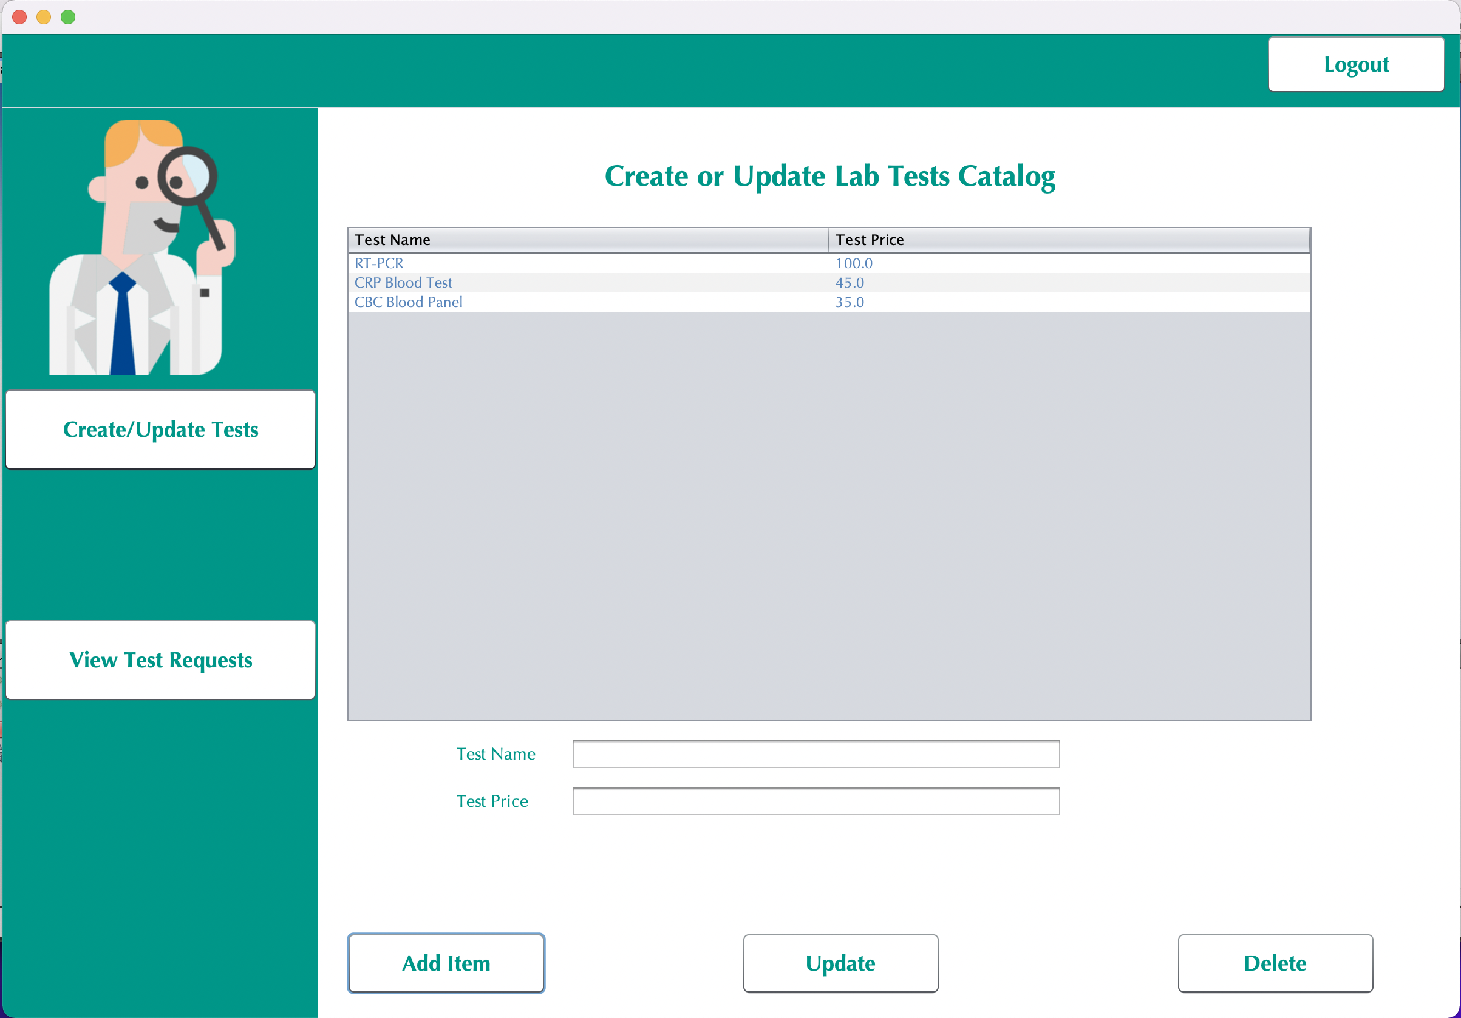

Slide 38
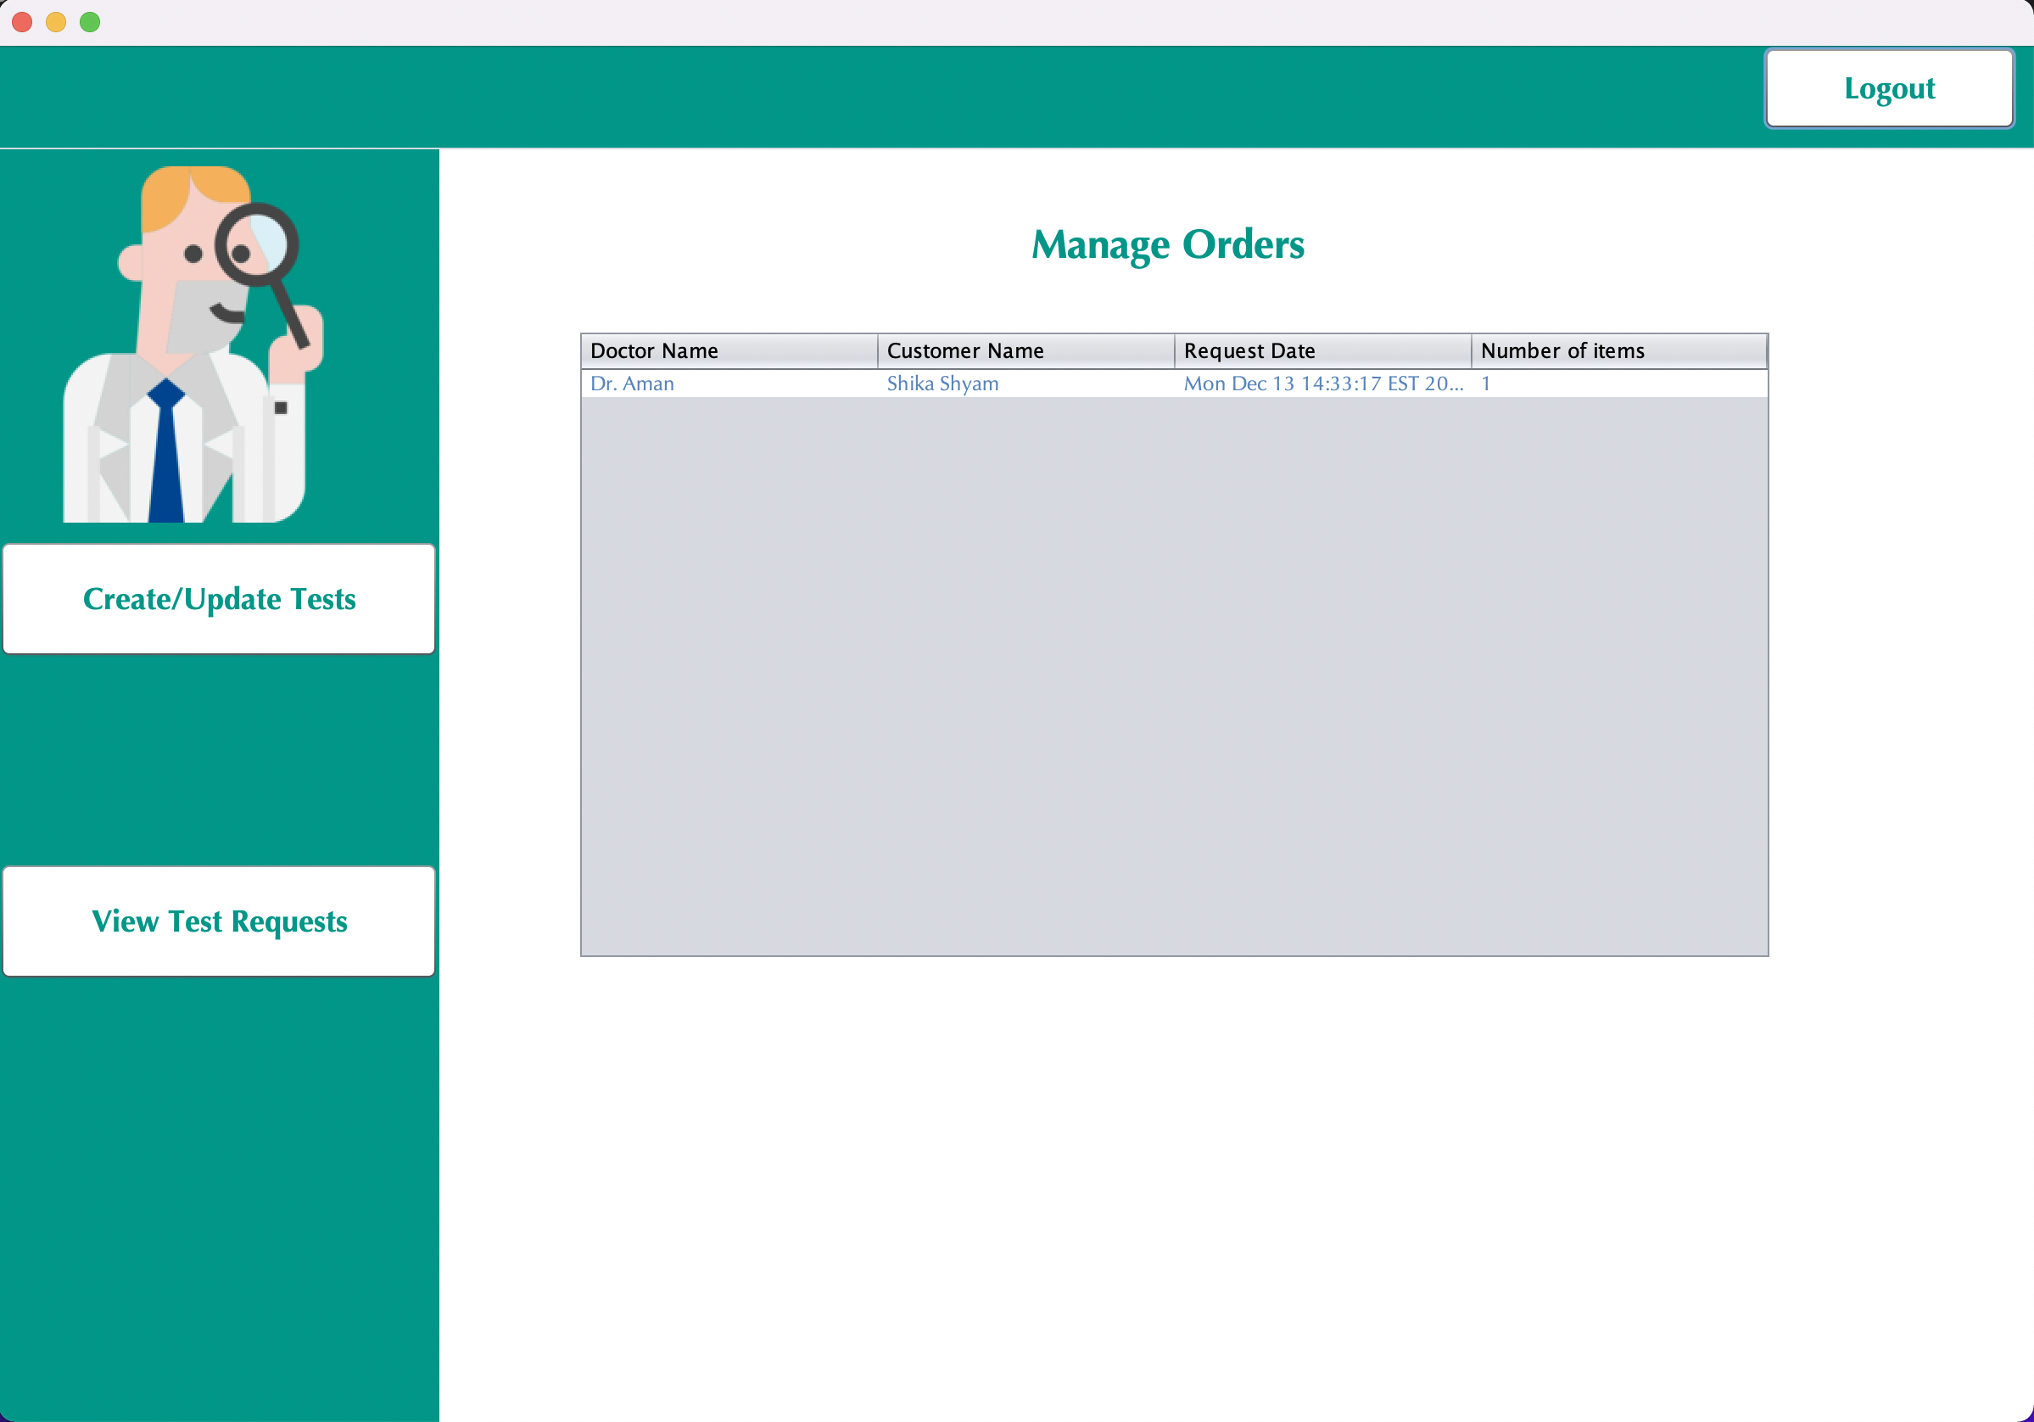

Slide 39
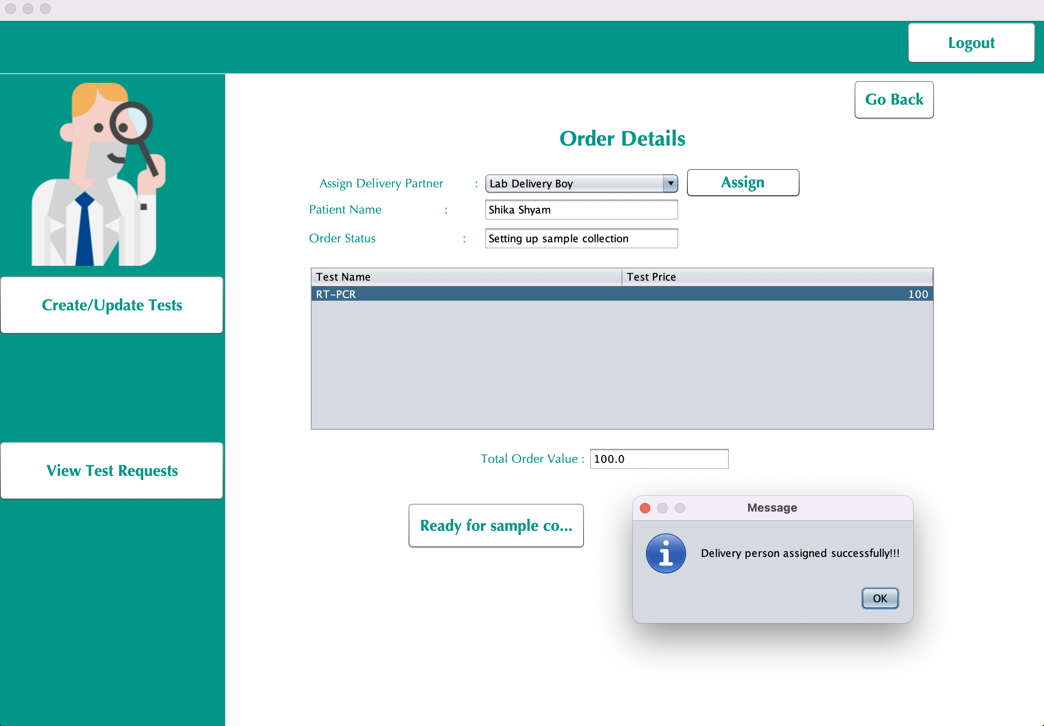

Slide 40
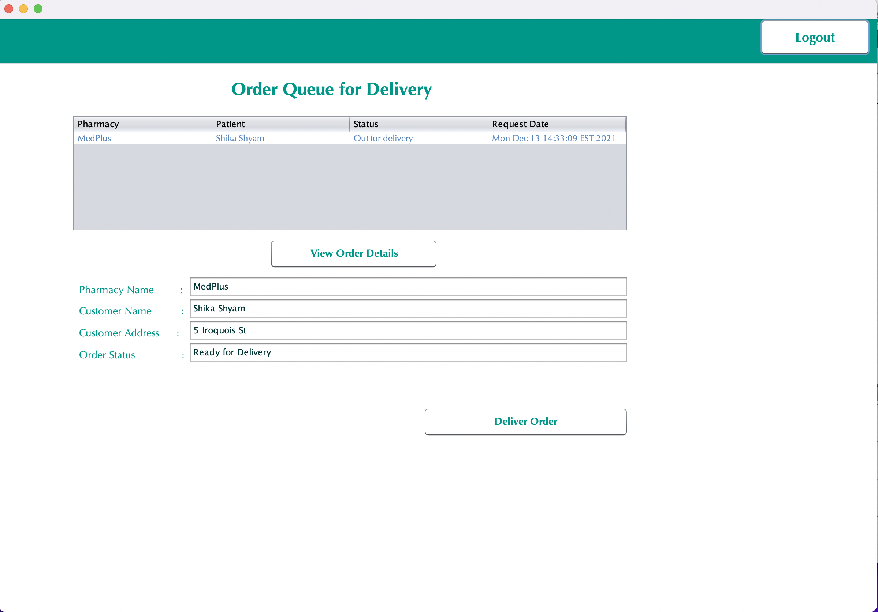

Slide 41
Food Enterprise Functionalities
Transportation Enterprise Functionalities
Integration and linking between Enterprises
Architecture Diagram
ALISHA MARY ANGALAN
CONTRIBUTIONS
STATEMENT
Hospital Enterprise Functionalities
User Interface
Integration and Testing
PowerPoint Presentation
SHIKA SHYAM
Accommodation Enterprise Functionalities
GIT repo setup and administration
UML Class and Sequence Diagrams
Testing
SAI RAGHAVENDRA VIRAVALLI

Slide 42
ProtectYOU
THANK YOU

